Slide 1
The University of Virginia, Rolling Stone Magazine, and Defamation Law
Presented by
Conrad Shumadine and Brett Spain
March 29, 2017
3:00-5:00
Hilton Garden Inn Town Center

Slide 2
The Power of Words

Slide 3
Overview of the Article

Slide 4
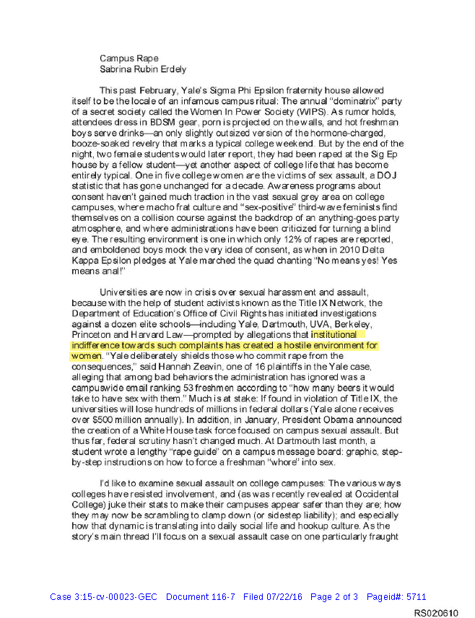
A Story in Search of a Target: The Reporter’s “Pitch”

Slide 5
A Story in Search of a Target: The Reporter’s “Pitch”

Slide 6
Elements of the “Pitch”
Theme – The institutional indifference toward sexual misconduct complaints has created a hostile environment for women.
Going to demonstrate how that indifference is translating “into a daily social life and hookup culture”
Indifference of students
Indifference of the administration
Going to focus on a “specific sexual assault case on one particularly fraught campus”

Slide 7
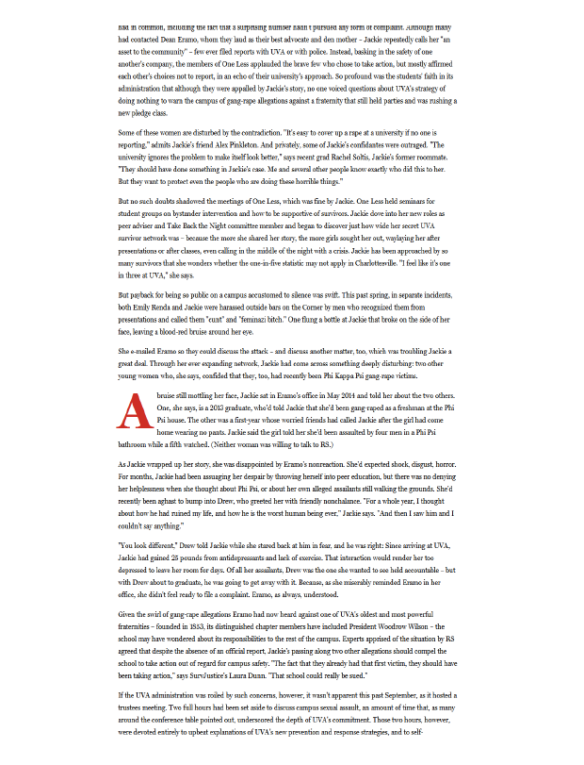
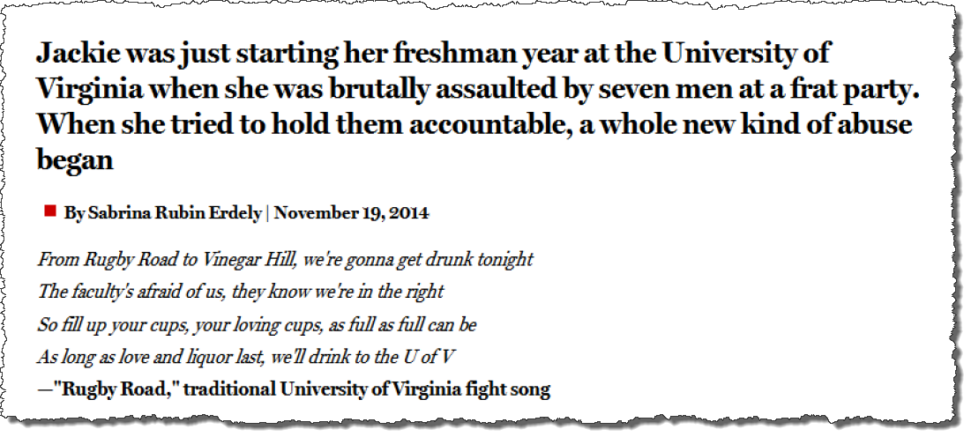
The Lead-In

Slide 8
Jackie’s Story
A few weeks into school, she went on a date with a handsome third-year student (“Drew”)
Took her to a party at Phi Kappa Psi
Took her upstairs into a pitch black room where a group of men was waiting for her
Pushed her through a glass table, beat her, and seven men took turns raping her for three hours, while Drew and another man gave instructions and encouragement
Suggests that this was possibly an initiation ritual
Woke up at 3:00 a.m., the room was empty but the party was still going on; she left barefoot, beaten, and bloodied but nobody seemed to notice her or say anything

Slide 9
“Hookup Culture” – Jackie’s Friends
After the attack, Jackie calls three friends; find her on a picnic table with the fraternity house looming behind
Debate the social price of reporting the rape
Female friend’s view wins out:
“Her reputation will be shot for the next four years”
“She’s gonna be the girl who cried ‘rape,’ and we’ll never be allowed into any frat again.”
A month later, her friends are “now impatient for Jackie to rejoin the merriment”
“You’re still upset about that?”
“Cindy, a self-described hookup queen, said she didn’t see why Jackie was so bent out of shape. ‘Why didn’t you have fun with it?’ Cindy asked. ‘A bunch of hot Phi Psi guys?”

Slide 10
“Hookup Culture” - The #1 Party School in the Country According to Playboy Magazine

Slide 11
“Rugby Road” (cont.)

Slide 12
After the Alleged Assault

Slide 13
Indifference of the Administration
Dean Nicole Eramo (Head of the Sexual Misconduct Board)
UVA caters to victim choice/discourages reporting and meaningful sanctions
In explaining why UVA doesn’t publish rape statistics, the article claims that Dean Eramo “answered wryly, ‘Because nobody wants to send their daughter to the rape school.’”
Dean Eramo discouraged Jackie from telling her story and had no reaction when Jackie later told her of two other students who claimed to have been gang raped at Phi Psi
No warning to the campus

Slide 14
Editor’s Note

Slide 15
Haven Monahan

Slide 16
Overview of Defamation Law

Slide 17
Elements of Defamation
In Virginia, the elements of defamation are:
(1) publication of
(2) an actionable statement with
(3) the requisite intent.

Slide 18
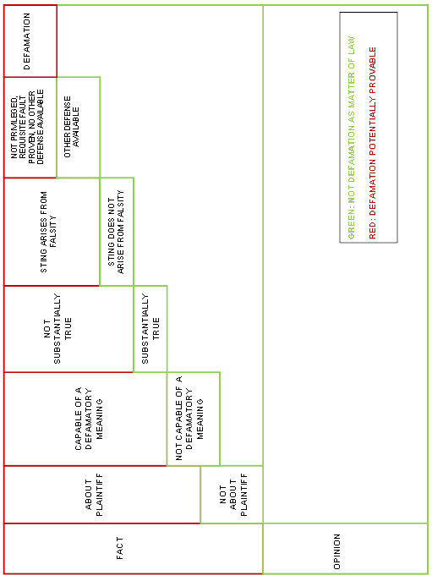
The Path to a Defamation Claim
Provided Courtesy of Gilbert E. “Bud” Schill, Jr. at McGuireWoods LLP and Robyn H. Hansen at Jones, Blechman, Woltz & Kelly, P.C.

Slide 19
Courts and Litigants Often Confuse Falsity and Defamatory Meaning
Falsity
False statement of fact
False implication arising from true facts
Defamatory Meaning
“[T]ends to injure one's reputation in the common estimation of mankind, to throw contumely, shame, or disgrace upon him, or which tends to hold him up to scorn, ridicule, or contempt, or which is calculated to render him infamous, odious, or ridiculous.” Schaecher v. Bouffault, 290 Va. 83, 92 (2015)

Slide 20
“Of and concerning”
To be actionable, a statement must be “of and concerning” the plaintiff
The statement does not have to identify the plaintiff by name.
It is sufficient if the plaintiff can be reasonably identified from the context of the statement.

Slide 21
Requisite Intent
Applicable Standard of Fault
Negligence – for private figures
Actual Malice – for public officials and public figures

Slide 22
“Of and concerning”
Who can be a defamation plaintiff?

Slide 23
Dean Eramo
Mentioned 31 times by name
Includes a picture of her
Other references to the university and the administration
Specific statements

Slide 24
References to Eramo’s Position
“Lots of people have discouraged her from sharing her story, Jackie tells me with a pained look, including the trusted UVA dean to whom Jackie reported her gang-rape allegations more than a year ago.”

Slide 25
Post-Article Statements
“[Jackie] was kind of brushed off by her friends and by the administration… And, eventually, when she did report it to the administration, the administration did nothing about, they did nothing with the information. And they even continued to do nothing even when she eventually told them that she had become aware of two other women who were also gang raped at the same fraternity.”

Slide 26
Post-Article Statements (cont.)
“As I’ve already told you, the gang rape scene that leads the story is the alarming account that Jackie – a person whom I found to be credible – told to me, told her friends, and importantly, what she told the UVA administration, which chose not to act on her allegations in any way – i.e., the overarching point of the article. That is the story: the culture that greeted her and so many other UVA women I interviewed, who came forward with allegations, only to be met with indifference.”

Slide 27
Statement #1
“Jackie was just starting her freshman year at the University of Virginia when she was brutally assaulted by seven men at a frat party. When she tried to hold them accountable, a whole new kind of abuse began.”

Slide 28
Are you kidding me?

Slide 29
Can you identify this house?
Multiple specific references to Phi Kappa Psi

Slide 30
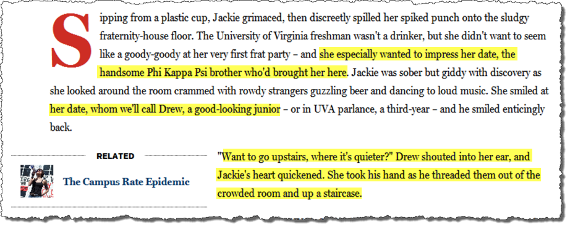
Can you identify these brothers?

Slide 31
Can you identify these brothers? (cont.)

Slide 32
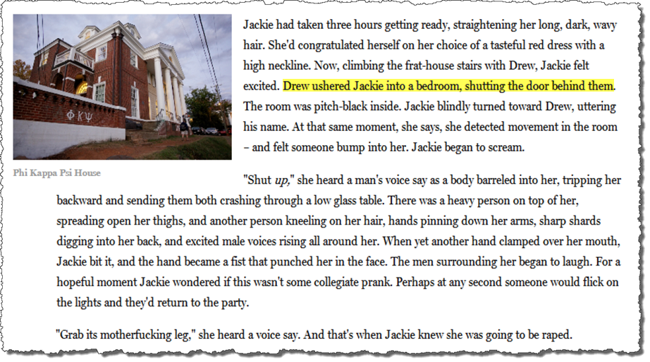
Can you identify these brothers? (cont.)

Slide 33
Can you identify these brothers? (cont.)

Slide 34
Can you identify these brothers? (cont.)

Slide 35
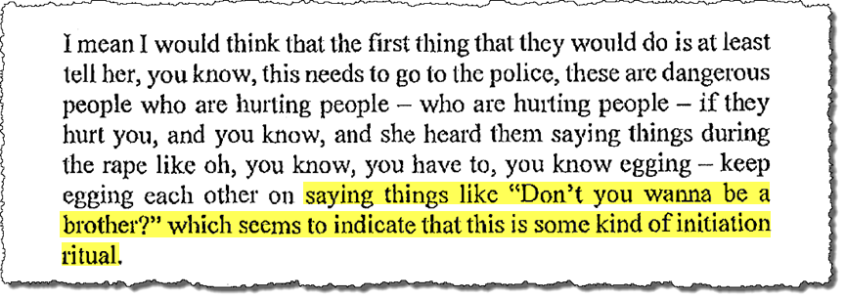
Ritual or puffery?

Slide 36
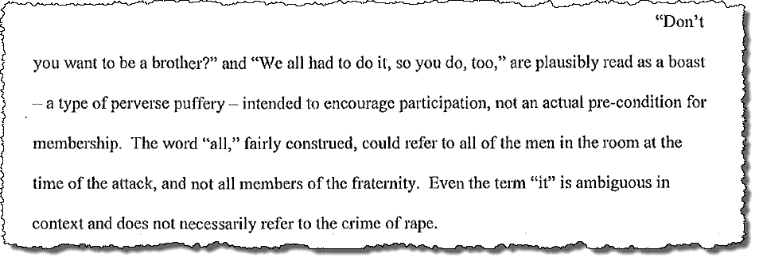
Ritual or puffery? (cont.)

Slide 37
Can you identify Jackie’s friends?

Slide 38
Can you identify Jackie’s friends? (cont.)

Slide 39
False Attribution of Quotes
“[R]egardless of the truth or falsity of the factual matters asserted within the quoted statement, [a false] attribution may result in injury to reputation because the manner of expression or even the fact that the statement was made indicates a negative personal trait or an attitude the speaker does not hold.”
Tharpe v. Saunders, 285 Va. 476, 482 (2013) (quoting Masson v. New Yorker Magazine, Inc., 501 U.S. 496, 511 (1991))

Slide 40
Statements of Fact v. Opinion

Slide 41
Rolling Stone – It’s all opinion
The defamatory implications underlying Eramo’s claims are based on “two subjective opinions”:
UVA failed to take appropriate action to warn the campus about Jackie’s allegations and did not undertake an investigation soon enough; and
UVA’s “practice of deferring to ‘victim choice’ … has the effect of causing victims not to pursue meaningful action.”

Slide 42
Rolling Stone – It’s all opinion

Slide 43
Underlying Factual Statements
“While pure expressions of opinion are not actionable, ‘[f]actual statements made to support or justify an opinion . . . can form the basis of an action for defamation.’”
Raytheon Technical Servs. Co. v. Hyland, 273 Va. 292, 303(2007)

Slide 44
Defamatory Meaning

Slide 45
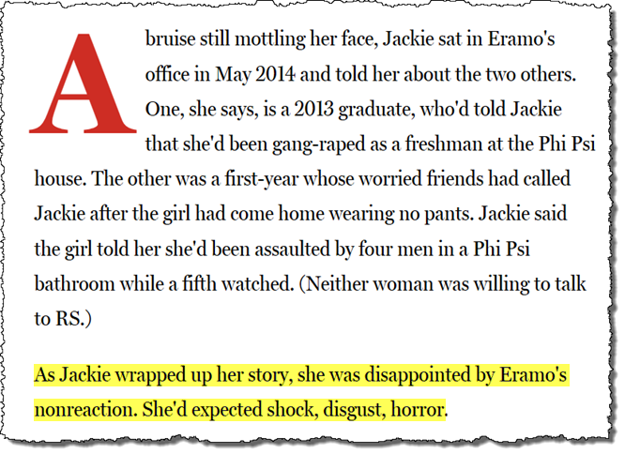
Dean Eramo’s “nonreaction”

Slide 46
Dean Eramo’s “nonreaction”

Slide 47
Rolling Stone’s Argument

Slide 48
Defamation by picture?

Slide 49
Artistic leeway

Slide 50
Fact Checker

Slide 51
Are you kidding me? #2

Slide 52
Republication

Slide 53
Our Worst Nightmare – 12/5/14
Today Jackie was interviewed by police but declined to report; her explanation to me for why she didn’t go forward was lacking. I’ve been trying to verify the identity of her assailant, and when I asked for help, it spiraled into confusion. By the time we ended our conversation, I felt nearly certain that she was not being truthful….
I’m not saying Jackie wasn’t raped in that
house, or on that night. However, Jackie isn’t credible.
We have to issue a retraction.

Slide 54
Damages

Slide 56
Four Categories of Defamation per se
(1) Those which impute to a person the commission of some criminal offense involving moral turpitude, for which the party, if the charge is true, may be indicted and punished.
(2) Those which impute that a person is infected with some contagious disease, where if the charge is true, it would exclude the party from society.
(3) Those which impute to a person unfitness to perform the duties of an office or employment of profit, or want of integrity in the discharge of the duties of such an office or employment.
(4) Those which prejudice such person in his or her profession or trade.

Slide 57
Will the Verdict Stand?

Slide 58
Actual Malice – A Roadmap
“[P]laintiff offers evidence that could lead a jury to determine that Erdely had a preconceived story line and may have consciously disregarded contradictory evidence.”
Email before interviewing President Sullivan already described what the story would say
Five prior stories with similar themes
Students felt she disregarded what they had to say about Dean Eramo

Slide 59
Actual Malice – A Roadmap (cont.)
(2) “[P]laintiff has produced evidence supporting the inference that Erdely should have further investigated Jackie's allegations.”
Knew the name of at least one of her “friends” and did not try to contact her.
Jackie did not provide full names of her attackers, and Erderly did not try to get their side.
Erderly did not try to get documents that Jackie said would corroborate her story.
Erderly did not interview Jackie’s mother, who Jackie said destroyed the blood-stained dress.

Slide 60
Actual Malice – A Roadmap (cont.)
(3) “[P]laintiff has presented evidence suggesting that Erdely had reasons to doubt Jackie's credibility.”
“Erdely noted disbelief about Jackie's assertion as to the identities of the two other victims; Erdely was put on notice that Jackie's alleged rape, by individuals supposedly being recruited into the fraternity, occurred several months before fraternity recruitment events; and that Erdely found Jackie's story of three women being gang-raped at the same fraternity too much of a coincidence.”
Knew that Jackie’s story changed but did not press her on the inconsistencies.

Slide 61
Actual Malice – A Roadmap (cont.)
(4) “[P]laintiff offers evidence suggesting that at least three individuals advised Erdely that her portrayal of Eramo was inaccurate.”
(5) “[P]laintiff offers evidence regarding how, between the November 18 publication date and the December 5th Editor's Note, Rolling Stone, through internal conversations and discussions with outside sources, concluded that their trust in Jackie had been ‘misplaced.’”

Slide 62
Conrad Shumadine Brett Spain Willcox & Savage, P.C. 440 Monticello Avenue, Suite 2200 Norfolk, VA 23510-2243 757-628-5500 www.willcoxsavage.com

