Slide 1

Recent Developments in
Professional Regulation
Materials credited to the following and VSB.
Permission granted for reproduction.
Carolyn Grady,
Renu M. Brennan,
Elizabeth K. Shoenfeld,
VIRGINIA BEACH BAR ASSOCIATION ETHICS
SEMINAR 2022 and Re-broadcast
1

Slide 2

Complaints Received:
• 3,115 FY 2022
• 2,924 FY 2021
• 3,091 FY 2020
• 3,123 FY 2019
• 3,156 FY 2018
• 3,304 FY 2017
• 3,162 FY 2016
• 3,346 FY 2015
• 3,546 FY 2014
• 3,713 FY 2013
2

Slide 3

FY 2022
2,151 – 69% were resolved summarily at the initial
Intake level after review and evaluation.
463 – 14.8% were resolved through proactive
investigations by Intake.
474, including 12 Receiverships – 16.2% were formally
opened and assigned to bar counsel for investigation.
27 – were summarily closed in Intake because
Respondents’ law licenses were revoked.
3

Slide 4
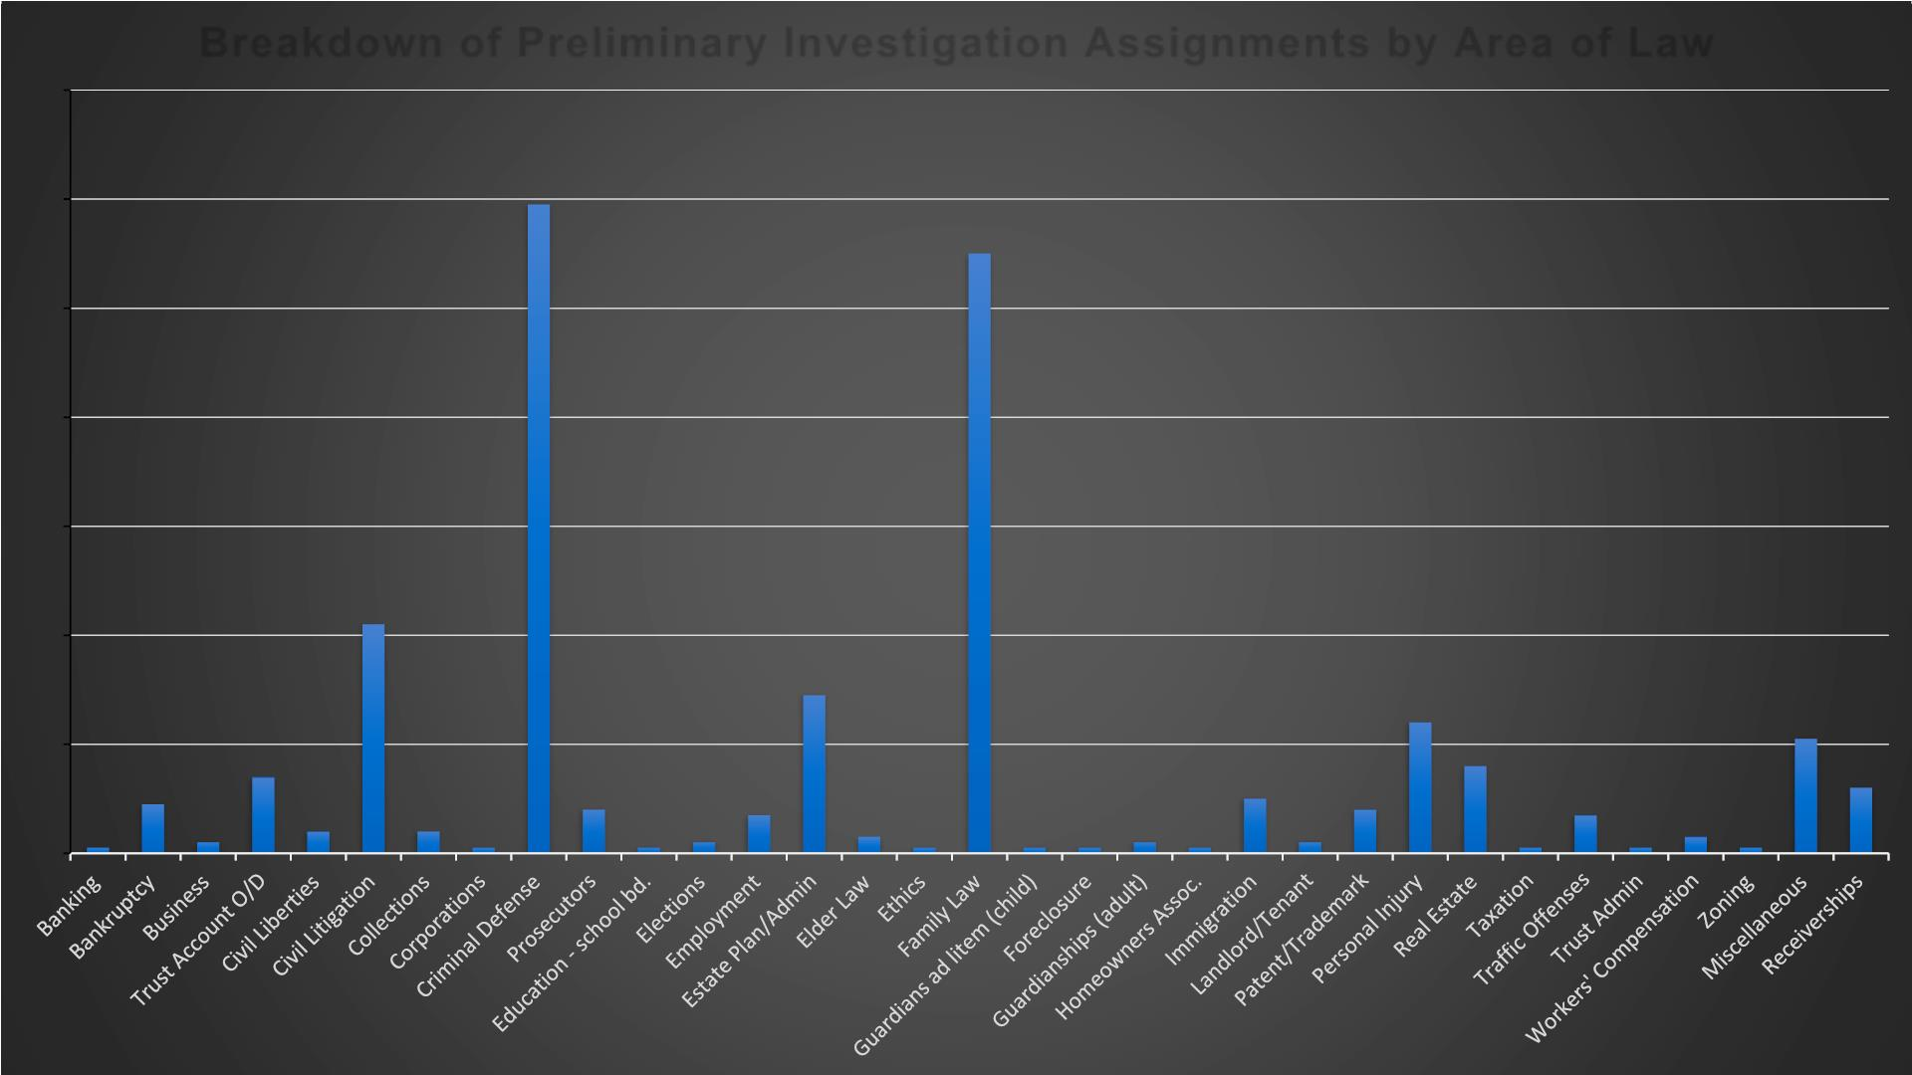
Breakdown of Preliminary Investigation Assignments by Area of Law
140
120
100
80
119
110
60
42
40
29
24
21
20
14
16
9
10
12
8
7
8
7
1
2
4
4
1
1
2
3
1
1
1
2
1
2
1
1
3
1
0

Slide 5
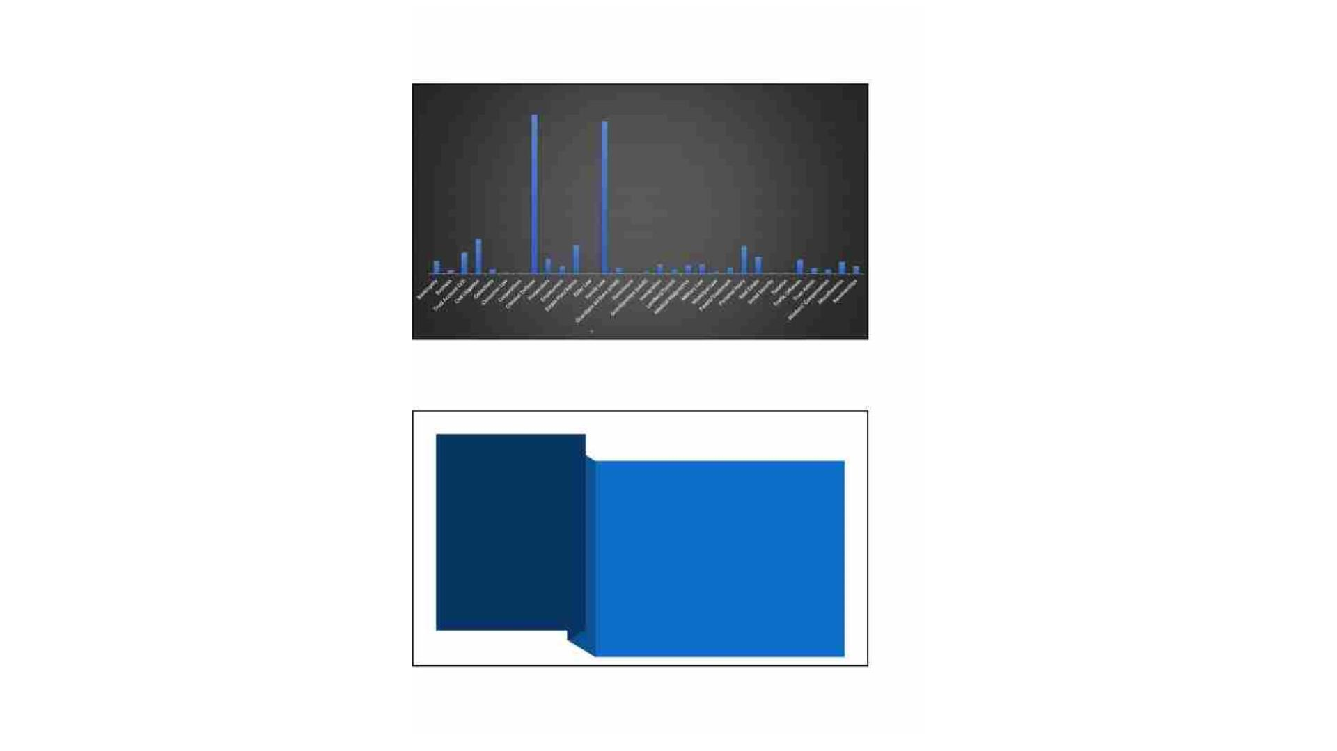
2021
1 6 0
Breakdown of Assignments by Area of Law
1 5 1
1 4 5
1 4 0
1 2 0
1 0 0
8 0
6 0
4 0
2 0
0
2 0
3 3
2 7
2 6
12
3
4
1
1
14
7
5
9
4
8 9
2
6
16
13
5 4
11
7
1
1 2
1 1
Breakdown of Assignments by Area of Law
Dismissals By
Bar Counsel,
Subcommittees,
Board, and
· Dismissed by Bar Counsel In House: 281 (does
not include cases dismissed without prejudice)
·
Dismissed by Subcommittee: 118
·
Dismissed by Board: 7 (includes 5 cases
dismissed without prejudice because of revocation
or permanent retirement of respondents; a
reciprocal case dismissed after hearing; and a
terms case dismissed after hearing)
Courts
·
Dismissed by Three-Judge Panels: 0
Permanent Exit – Rules provide for dismissal of
complaints if Respondent transfers to Disabled
Status and submits an affidavit that he/she will
not return to Active Status.
8
4

Slide 6

Dismissals De Minimis and Dismissals
for Exceptional Circumstances
Dismissals de Dismissal for
Minimis
Exceptional
Circumstances
Dec. 2019 -
June 2020
12 4
July 2020 –
June 2021
4 3
7 3
July 2021 –
June 2022
6

Slide 7

FY 22 Sanctions
Private Admonition or
Reprimand (38)
Public Discipline (71):
Admonition or Reprimand
(34)
Suspension (18)
Revocation (19)
7

Slide 8

• Paragraph 13-15
• Dismissals – lack of clear and
convincing evidence
• Dismissals De Minimis or
Exceptional Circumstances
• Private Discipline –
• Private Admonitions – Sua Sponte
Subcommittee
Dispositions
• Approve Agreed Dispositions (AD)
Private Reprimand, Public
Admonition or Reprimand
UNANIMOUSLY
• Charge of Misconduct – Set for
hearing at District Committee level,
maximum sanction of Public
Reprimand
• Certify to Disciplinary Board –
Misconduct if proven would justify
Suspension or Revocation
8

Slide 9

• Private Discipline shall be imposed
only in cases of minor Misconduct,
when there is little or no injury to any
of the following: a client, the public,
the legal system or the profession,
and when there is little likelihood of
repetition by the Respondent.
When is
Private
Discipline
Appropriate?
• Rebuttable presumption against
more than two determinations of
Private Discipline in 10 years.
Paragraph 13-7.E.
9

Slide 10

Private Discipline
FY 2022: 39 matters
Subject Matter
Number of Matters
Criminal Appeals
11
6
Civil Litigation
Estate
3
Administration/
Fiduciary Matters
Family Law
Criminal Trials
Other
6
4
9
10

Slide 11

Private Discipline Rules Violated FY 2022
Rule Violated
Number of Violations
1.3 (Diligence)
13
13
13
7
1.4 (Communication)
1.15 (Safekeeping Property)
1.5 (Fees)
1.1 (Competence)
6
1.16 (Declining or Terminating Representation)
8.1 (Bar Admission and Disciplinary Matters)
1.2 (Scope of Representation)
1.7, 1.8, 1.9 (Conflicts of Interest)
8.4 (Misconduct)
4
3
2
2
2
3.4 (Fairness to Opposing Party and Counsel)
1
4.2 (Communications with Persons Represented by
Counsel)
1
5.3 (Responsibilities Regarding Nonlawyer Assistants)
5.6 (Restrictions on Right to Practice)
1
1
5.8 (Procedures for Notification to Clients When a Lawyer
Leaves a Law Firm or When a Law Firm Dissolves)
1
11

Slide 12
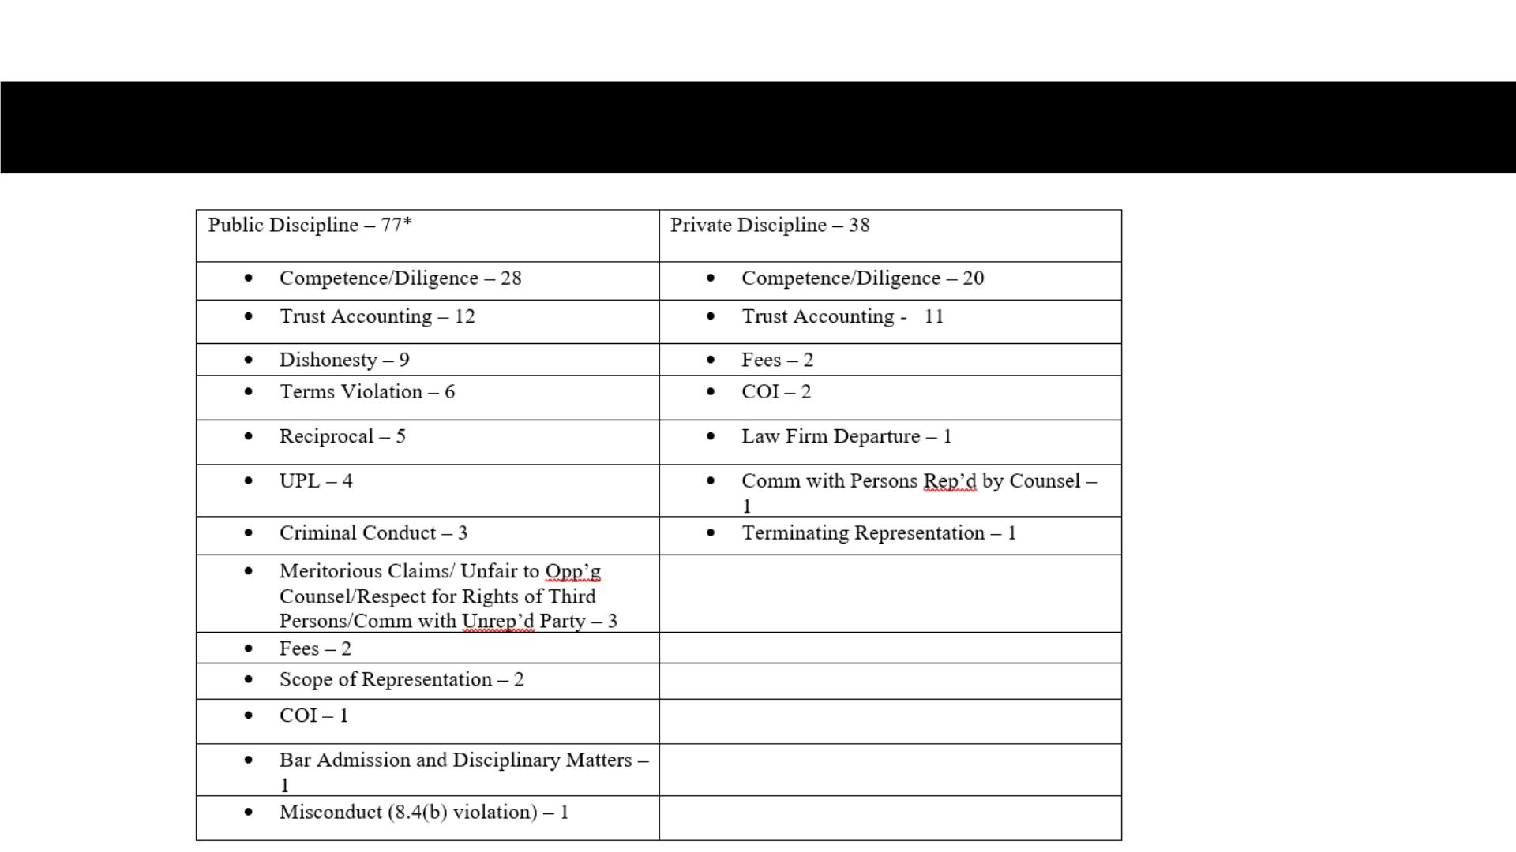
VIRGINIA SANCTIONS FY 22 (July 1, 2021 to June 30, 2022)
* Number of respondents
in each category.

Slide 13

“ABA Standards for Imposing Lawyer Sanctions”
Provide Analytical Framework
• Purpose of lawyer discipline:
vProtect the public
vEnsure the administration of justice
vMaintain the integrity of the profession
• Disciplinary Proceedings – Purpose of sanction to send a message to the public.
• The proceeding is not to punish, but for the purpose of preserving the courts of
justice from the official ministrations of persons unfit to practice in them. Norfolk
& Portsmouth Bar Ass’n v. Drewry, 161 Va. 833 (1933).
• The question is not what punishment may the offense warrant, but what does it
require as a penalty to the offender, as a deterrent to others and as an indication
to laymen that the courts will maintain the ethics of the profession. Maddy v.
District Committee, 205 Va. 652 (1964), quoting Corpus Juris Secundum,
Attorney and Client, Section 38.

Slide 14
Sanctions – Case Law
• In arriving at the punishment to be imposed, precedents are of little aid, and each case
must be largely governed by its particular facts, and the matter rests within the sound
discretion of the court. Maddy v. District Committee, 205 Va. 652 (1964), quoting Corpus
Juris Secundum, Attorney and Client, Section 38.
• The Board has a perfect right to consider an attorney’s prior disciplinary record when
determining an appropriate sanction. Shea v. Virginia State Bar, 236 Va. 442 (1988).
• While misconduct proved at a hearing, considered in isolation, might warrant a lesser
penalty, final sanction is properly based upon consideration of an attorney’s entire
disciplinary history. Tucker v. Virginia State Bar, 233 Va. 526 (1987).
• Purpose of lawyer discipline and self-regulation achieved when decisions articulate the
reasons for the decision. (Preface to “ABA Standards for Imposing Lawyer Sanctions”)
• Analyze type of offense, discipline imposed, policy considerations, aggravating and
mitigating circumstances.

Slide 15

1. Prior disciplinary offenses;
2. Dishonest or selfish motive;
3. Multiple offenses;
4. Bad faith obstruction of the disciplinary proceeding by
intentionally failing to comply with rules or orders of the
disciplinary agency;
ABA
Aggravating
Factors
5. Submission of false evidence, false statements, or
other deceptive practices during the disciplinary
process;
6. Refusal to acknowledge wrongful nature of conduct;
7. Vulnerability of victim;
8. Substantial experience in the practice of law;
9. Indifference to making restitution; and
10. Illegal conduct, including that involving the use of
controlled substances.
15

Slide 16

ABA Mitigating Factors
1. Absence of a prior disciplinary record;
2. Absence of a dishonest or selfish motive;
3. Personal or emotional problems;
4. Timely good faith effort to make restitution or to rectify
consequences of misconduct;
5. Full and free disclosure to disciplinary board or
cooperative attitude toward proceedings;
6. Inexperience in the practice of law;
7. Character or reputation;
8. Physical disability;
9. Delay in disciplinary proceedings;
10. Imposition of other penalties or sanctions;
11. Remorse; and
12. Remoteness of prior offenses.
16

Slide 17
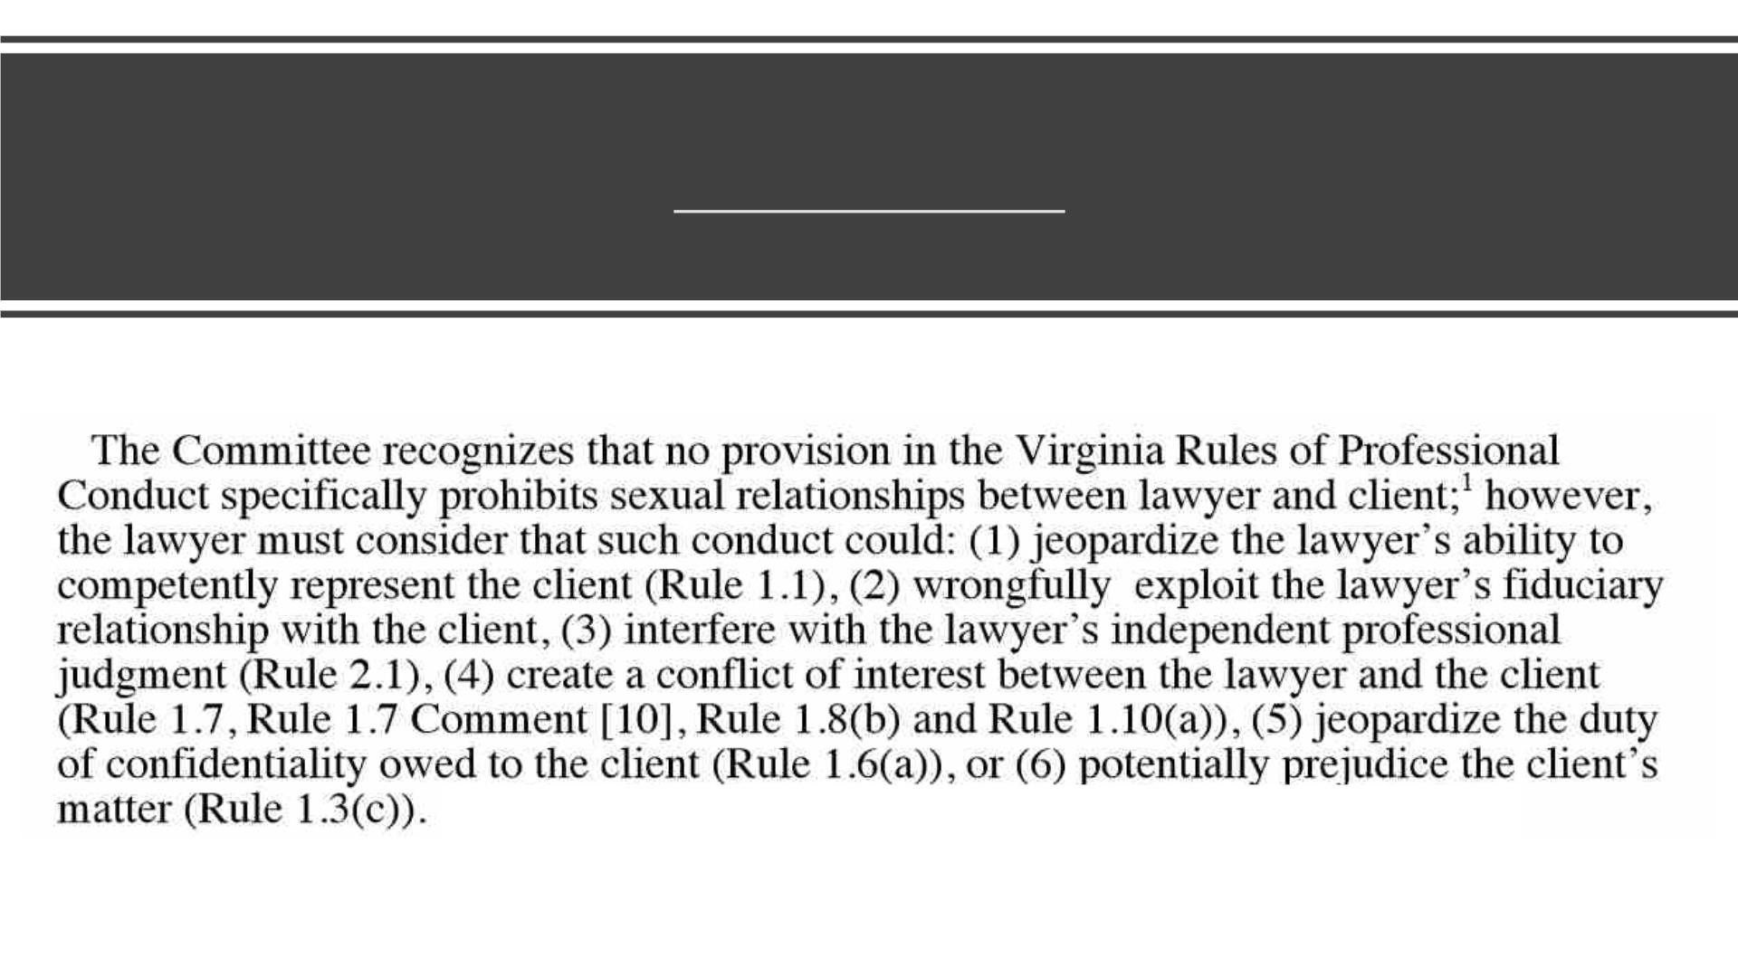
LEO 1853: Sexual Relationship With A Client

Slide 18

In the Matter of
Joseph Taylor
Brown
Public Reprimand
With Terms
Conflict of interest
18

Slide 19
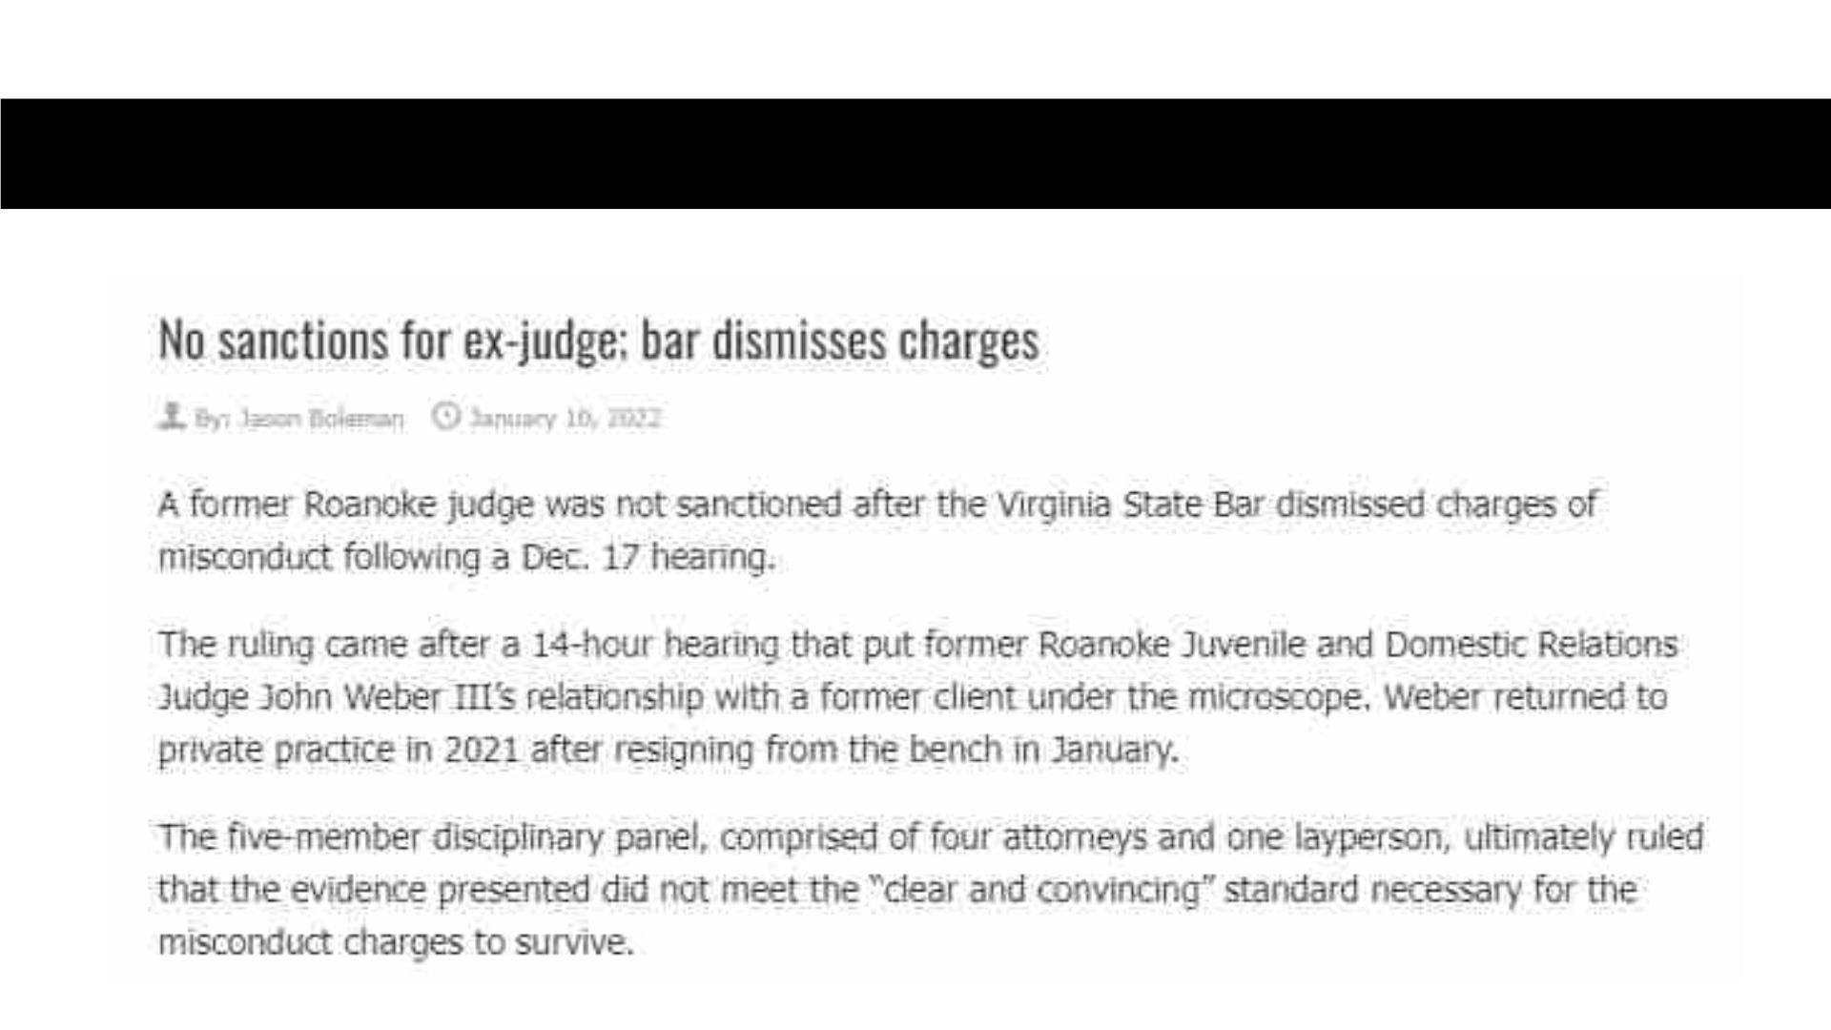
In the Matter of John Weber, III
Dismissed with Dissent
19

Slide 20
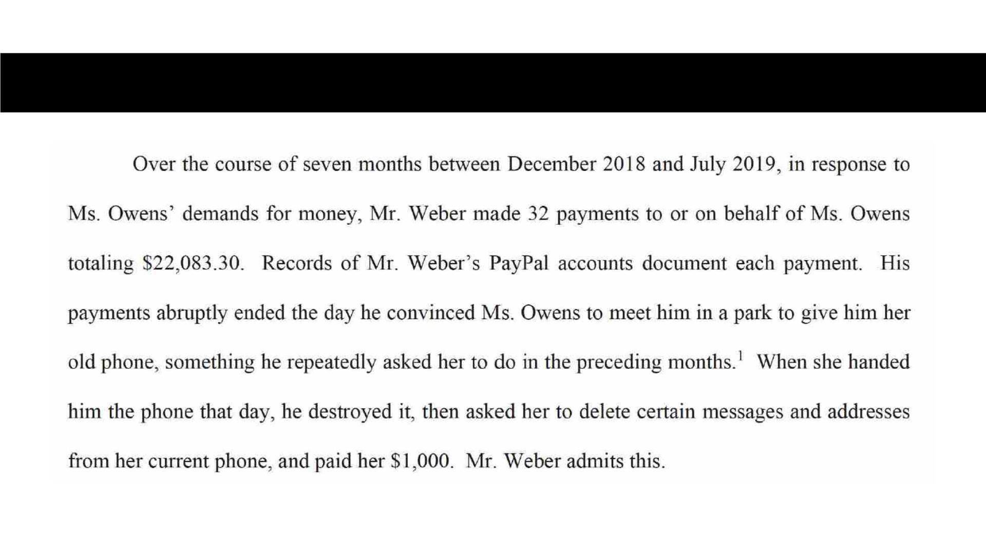
In the Matter of John Weber, III
Dismissed with Dissent
20

Slide 21
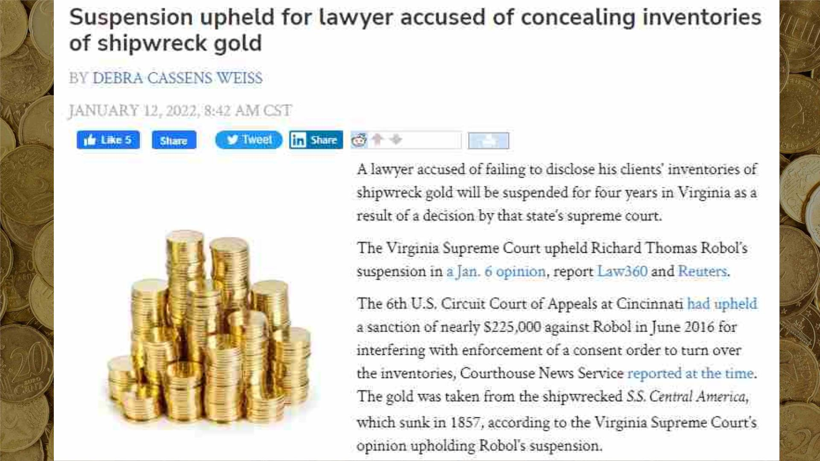

Slide 22
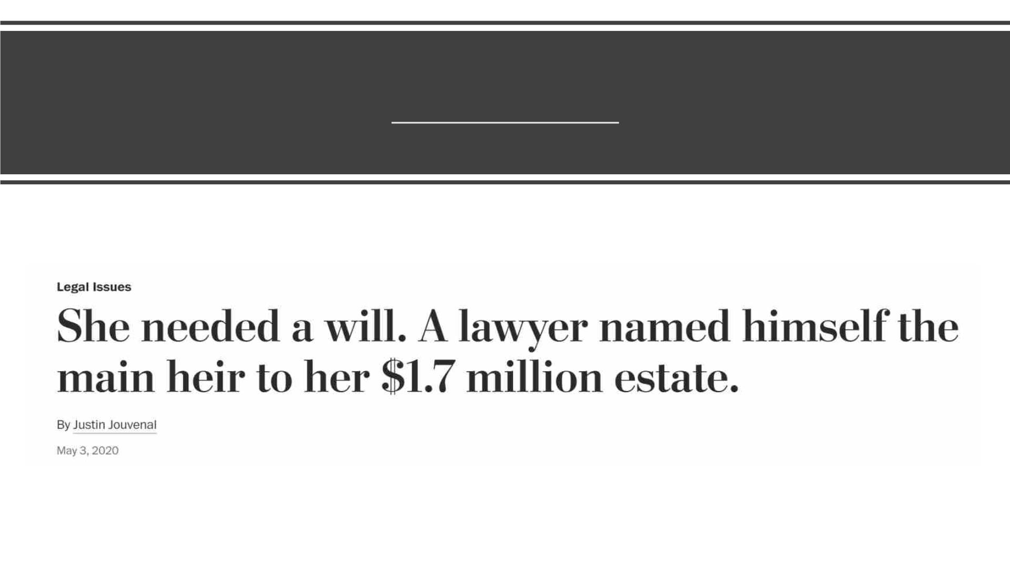
VSB v. Robert B. Machen
Revocation

Slide 23

In the
Matter of
Mark
Edward
Kellogg
Consent to
Revocation

Slide 24
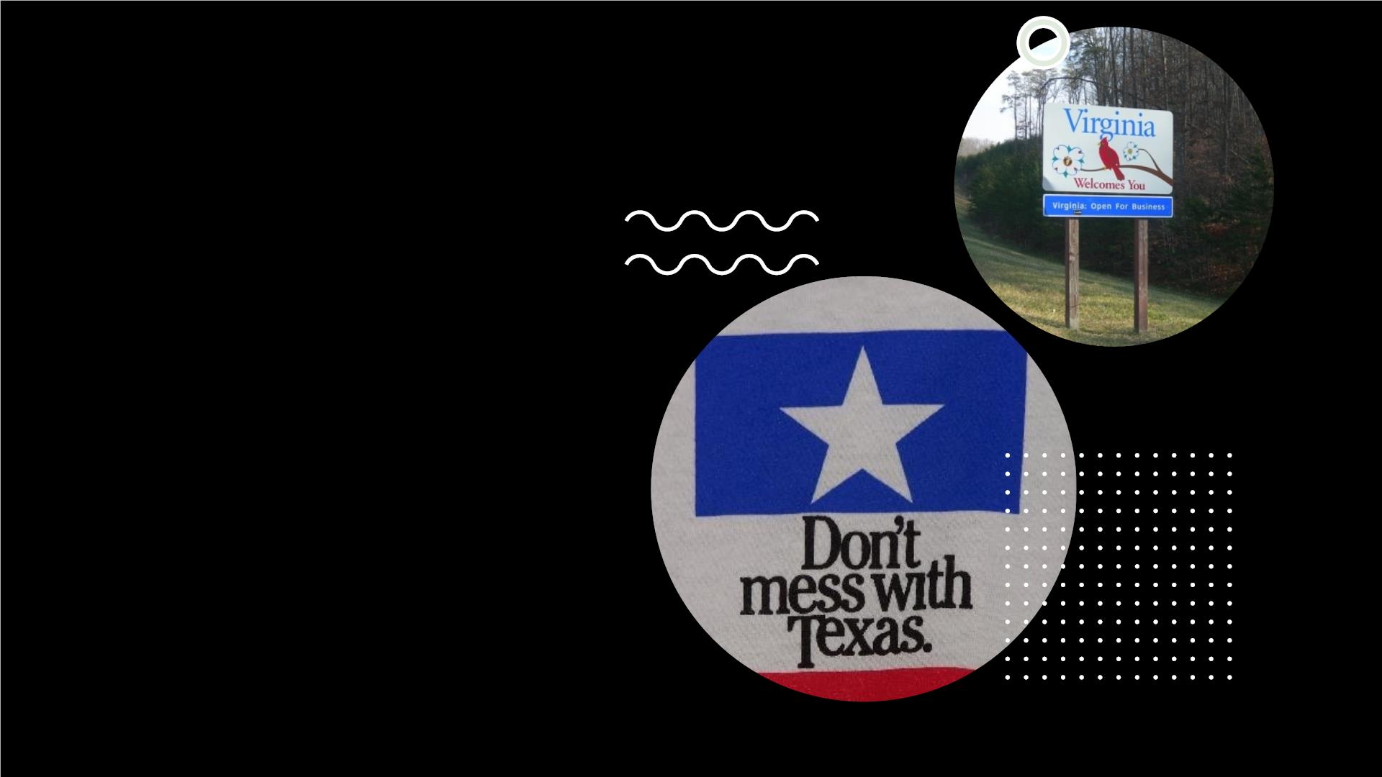
In the
Matters of
Edward
Allen
Malone

Slide 25
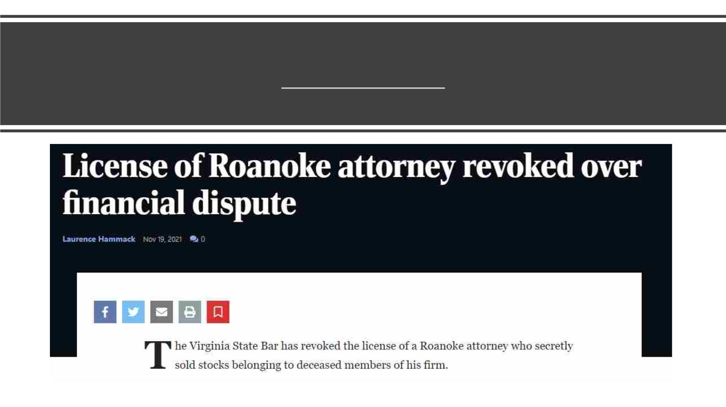
In the Matter of Glen Nelson Mackey, Jr.
Consent to Revocation

Slide 26
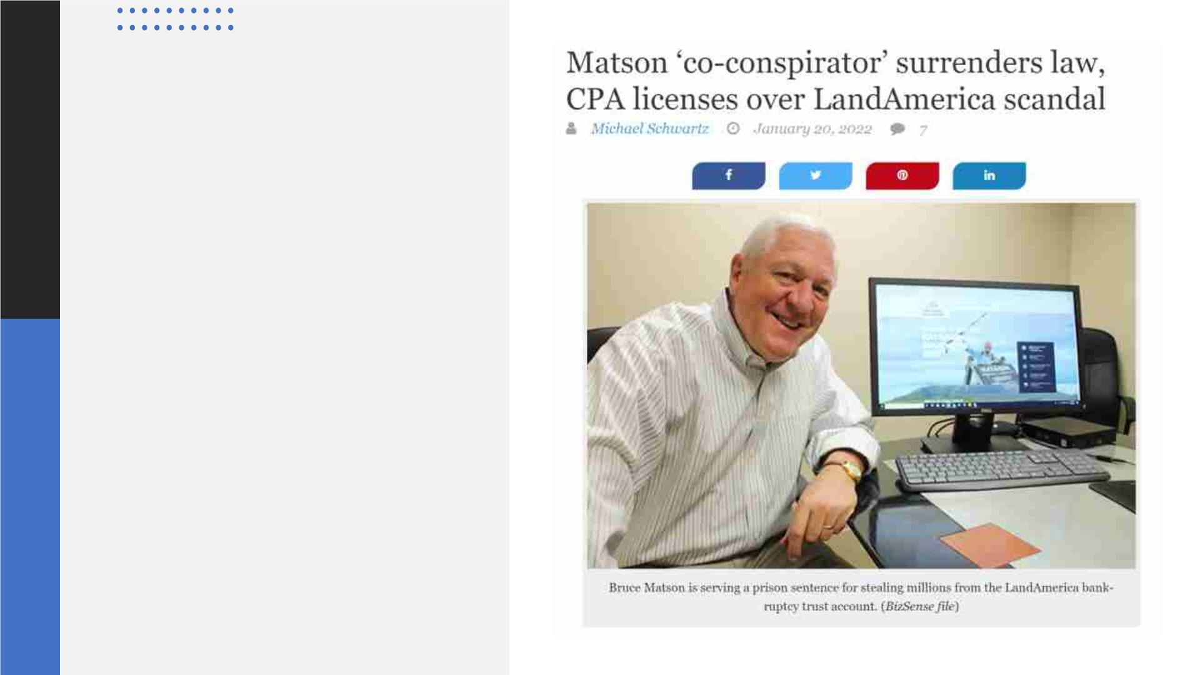
In the Matter of
Robert Bailey
Smith, IV
Consent to
Revocation

Slide 27

In the Matter of
Charles John
Covati
Paragraph 13-29 Requirements
• Within 14 days, give notice to all clients,
opposing attorneys, and presiding judges
with which currently handling matters.
Consent to
Revocation
• Within 45 days, make arrangements for
disposition of matters in accordance with
clients’ wishes.
• Within 60 days, give the bar proof that
you’ve done 1 and 2.
27

Slide 28
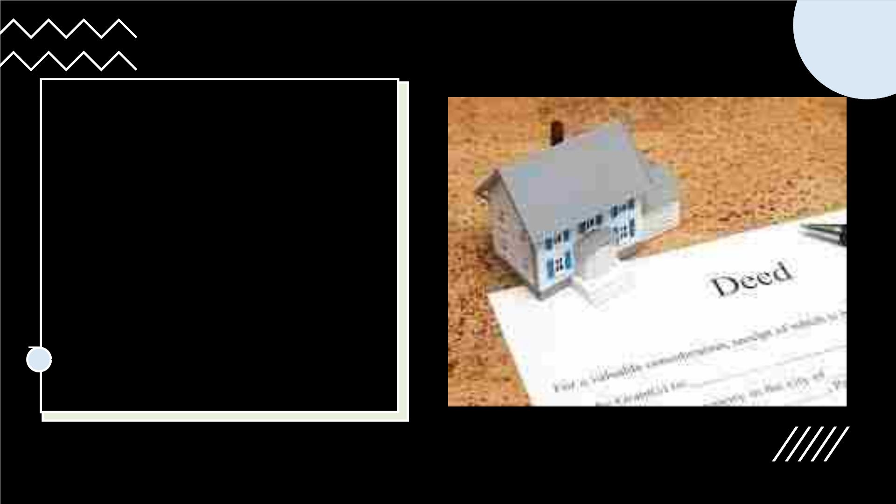
In the Matter of Jay
Arthur Rosenberg
Consent to Revocation
of Privilege to Practice
in Virginia
28

Slide 29

In the Matters of
Ellen Mary Lynch
Consent to
Revocation

Slide 30

Trust Accounting
Cases (often Trust
Account +)
30
This Photo by Unknown Author is licensed under CC BY-SA

Slide 31
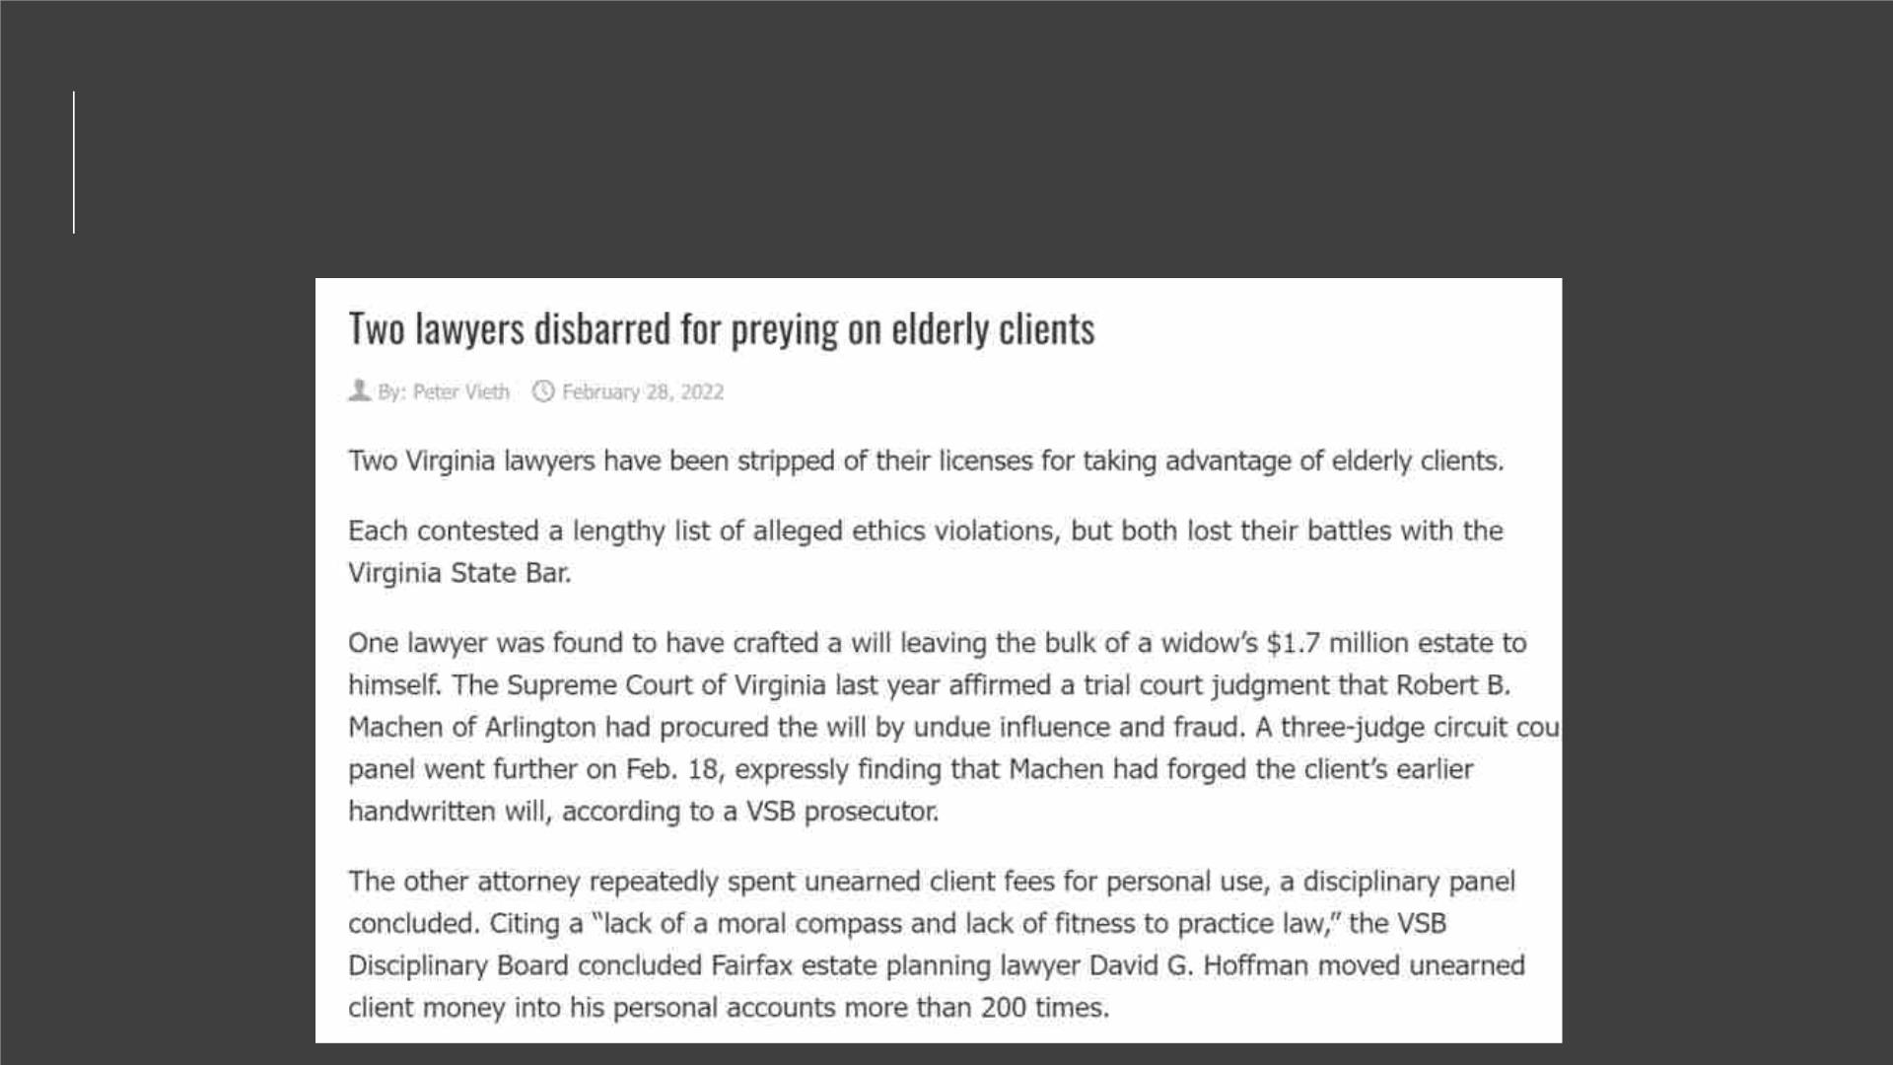
In the Matters of David Gary Hoffman
Revocation
31

Slide 32

In the Matter of
Michael Steven Arif
Five-Year Suspension
With Terms, then
Revocation

Slide 33
In the
Matter of
Robert
Steven
Pope
Effective Nov. 29, 2021, the Virginia State
Bar revoked the law license of Robert
Steven Pope of Aldie based on his affidavit
consenting to the revocation.
Consent to
Revocation

Slide 34

In the Matters of
Victor Rivera-
Nieves
Three-Year
Suspension

Slide 35

In the Matter of
Matthew Howard
Swyers
Two-Year
Suspension

Slide 36

Other Public Trust Accounting
Cases
• In the Matters of Britney Hope Maddux – Six-Month Suspension with Terms (for Terms Violation)
followed by 18-Month Suspension for violation of the Six-Month Suspension with Terms
• Darren Scott Haley – 18-Month Suspension, under appeal to SCV
• OlaDipo Akinwunmi AkinDeko – Nine-Month Suspension
• Melissa Lynch Freeman – Nine-Month Suspension with Terms
• Robert Hasbrouck Nutt, II – 90-Day Suspension
• Christopher Broughton Shedlick – Three-Month Suspension (Terms Violation)
• Jason Alexander Atkins – Public Reprimand with Terms
• Kevette Beard Elliott – Public Reprimand With Terms
• Walter Ware Morrison – Public Reprimand With Terms
• James Paul Kent, Jr. – Public Reprimand
• Daymen William Xavier Robinson – Public Reprimand
• Brenton Daniel Vincenzes – Public Reprimand (Terms Violation)

Slide 37

VSB ex rel Seventh District
Committee v. Jose Angel
Baez
Public Admonition

Slide 38

Legal Ethics
Opinion 1606
LEGAL FEES
COMPENDIUM
OPINION BY VSB
ETHICS COMMITTEE
NOVEMBER 22, 1994
APPROVED BY THE
SUPREME COURT OF
VIRGINIA
NOVEMBER 2, 2016
38

Slide 39

Administrative
Suspension for
Failure to Certify
Compliance or
Exemption from
Mandatory IOLTA
Rule – July 1, 2023
• Rule 1.15 on the safekeeping of
property
• Lawyers and Other People's
Money: A Resource for
Maintaining Trust Accounts (pdf)
• Maintenance of Trust
Accounts, Rules of Supreme
Court of Virginia, Part 6, § IV,
Paragraph 20
39

Slide 40

In the Matter of Jesus Diokono Salang

Slide 41

Unauthorized Practice of
Law
41
Brian Keith
Snyder/Consent to
Revocation
Brian Wesley Barger/8-
Month Suspension
Matthew James
Hunzeker/6-Month
Suspension
Tito Vladimir Alejandro
Castro/Public Reprimand
This Photo by Unknown Author is licensed under CC BY-NC

Slide 42

Failure to Self-Report
under Rule 8.3
In the Matter of Ardra Monique
O’Neal
Public Reprimand
In the Matter of Jason Andrew
Carey
Public Reprimand
42

Slide 43

In the Matter of Alicia Ellen
Rowedder
Six-Month Suspension
43
This Photo by Unknown Author is licensed under CC BY-SA

Slide 44

44
In the Matter of Denis
Charles Englisby
Public Reprimand with Terms
“the probability is that you still owe my firm the
amount that you tried to bankrupt.”

Slide 45

45
ETHICS/ABA JOURNAL
Lawyer reprimanded after he used
In the Matter of
Aaron Michael
Burgin
profanities while declaring himself best
advocate in courtroom
BY DEBRA CASSENS WEISS
Updated: A Virginia lawyer has been
publicly reprimanded after allegedly using
profanities in an email to a probation officer
who miscalculated sentencing guidelines for
one of his clients.
Public Reprimand
with Terms
The Seventh District Subcommittee of the
Virginia State Bar voted to reprimand lawyer
Aaron Michael Burgin, with conditions, ….

Slide 46

Competence/Diligence/Neglect
46

Slide 47
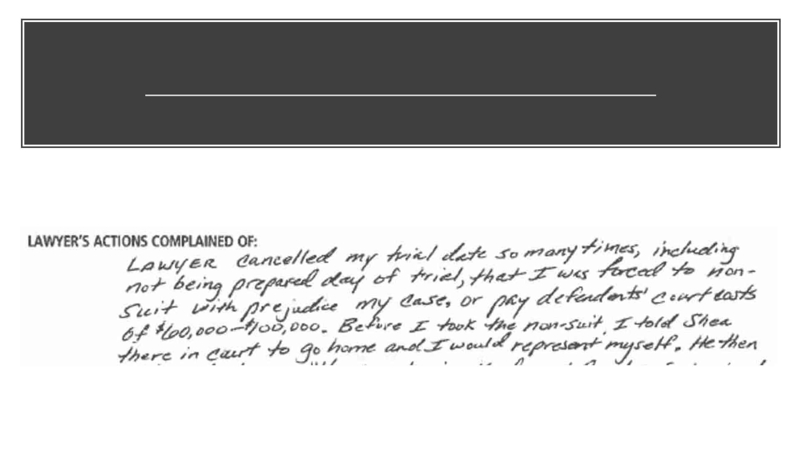
In the Matter of Kevin Peter Shea
Revocation
47

Slide 48

48
In the Matters of
Gerald R. Curran
and Demian John
McGarry
Public Reprimand

Slide 49
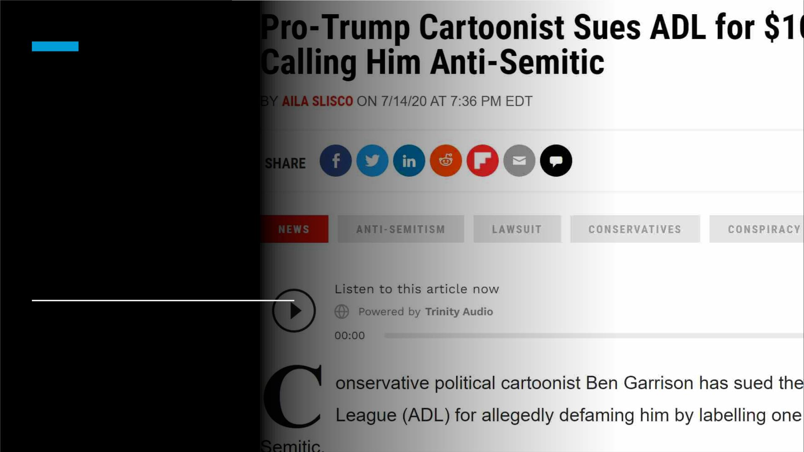
In the Matter of
Steven Scott Biss
Public Reprimand
Without Terms
49

Slide 50
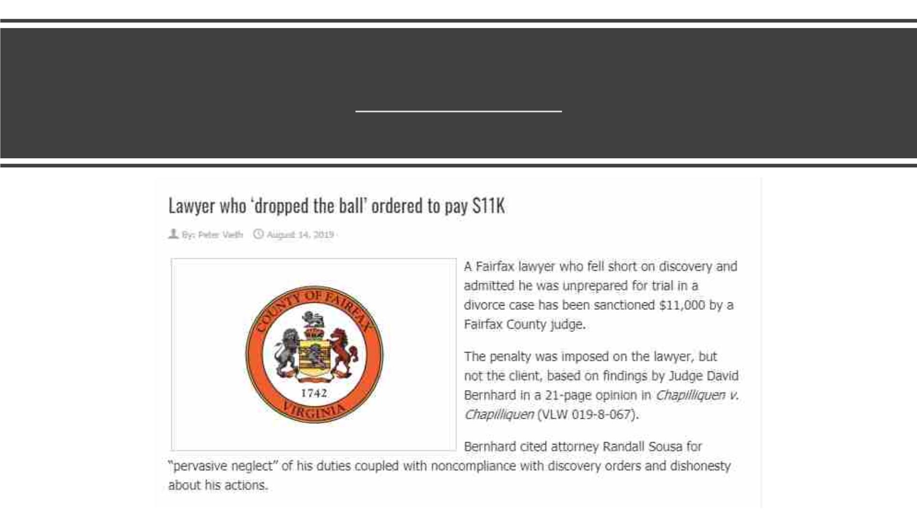
In the Matters of Randall Sousa
Revocation*
50

Slide 51

In the Matters of Barry Ray Taylor
Five-Year Suspension
• Attorney Receives 5-Year Suspension
for Misconduct in 4 Client Matters
• Attorney Barry Ray Taylor was admitted to
the Virginia bar in October 1994. He
previously received a three-year
suspension in August 2019 for three,
separate complaints for mismanaging his
attorney trust account, lacking diligence
and competence with clients and
misconduct, court records show.

Slide 52


Slide 53

In the Matter of Donald Frank Rosendorf
Public Reprimand
42 U.S. Code Section 1983 - Civil action for deprivation of rights
53

Slide 54
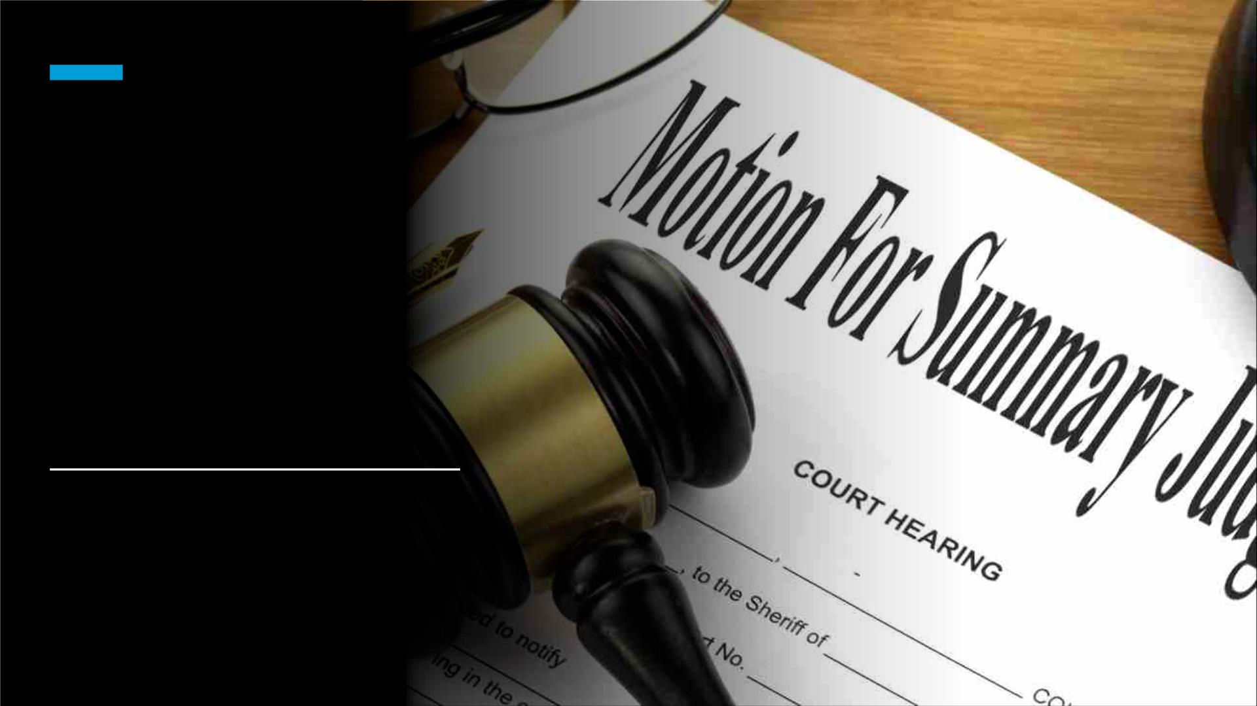
In the Matter of
Alexander
Harkness Bell
Public Reprimand
54

Slide 55

In the Matter of
Jesse Burkhardt
Beale
Public Reprimand

Slide 56


Slide 57

In the Matter of
Brian Damas
Thoman
Public
Reprimand with
Terms
This Photo by Unknown Author is licensed under CC BY-SA

Slide 58

In the Matter of
Keith Hamner
Waldrop
Public Reprimand
with Terms

Slide 59

In the Matter
of Andrew
Paul Hill
Public
Reprimand

Slide 60

VSB & Commissioners
of Accounts
§ 64.2-1215. Power of commissioner of
accounts to enforce the filing of inventories.
B. Whenever the commissioner of accounts reports
to the court that a fiduciary who is an attorney-at-
law licensed to practice in the Commonwealth has
failed to make the required return within 30 days
after the date of service of a summons, the
commissioner of accounts shall also mail a copy of
his report to the Virginia State Bar.
This Photo by Unknown Author is licensed under CC BY-SA
60

Slide 61

61
Virginia
Code
§64.2-1216
§ 64.2-1216. Failure to account;
enforcement.
C. Whenever the commissioner of accounts
reports to the court that a fiduciary who is
an attorney-at-law licensed to practice in
the Commonwealth has failed to make the
required settlement within 30 days after the
date of service of a summons, the
commissioner of accounts shall also mail a
copy of his report to the Virginia State Bar.

Slide 62
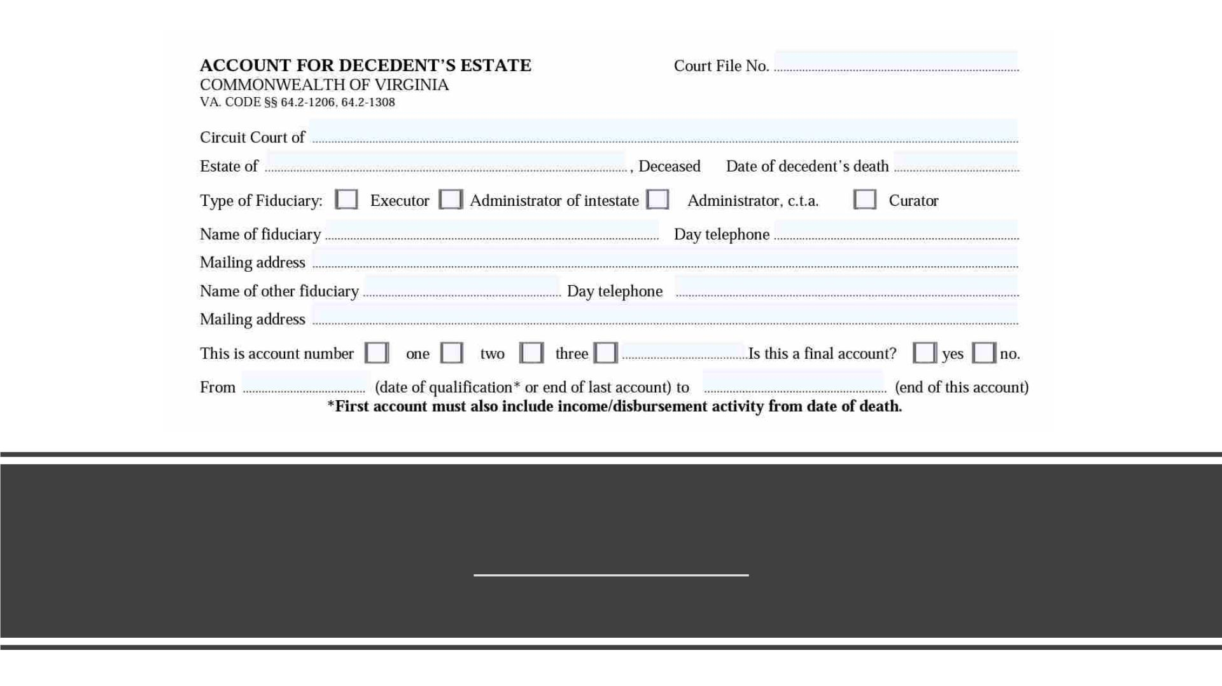
In the Matter of Judy Raye Moats
Consent to Revocation
62

Slide 63

Public Reprimands
In the Matter of James Paul Kent
In the Matters of Mark Joseph
Madigan
In the Matter of Madeline Agnes
Trainor
In the Matter of Thomas Page
Cheeley
63
This Photo by Unknown Author is licensed under CC BY

Slide 64

Procedural Defaults in Appeals
In the Matters of Christopher Matthew
Reyes
Consent to Revocation
In the Matter of Alfred Robertson, Jr.
One-Year and One-Day Suspension
In the Matter of Robert Charles Neeley, Jr.
Public Reprimands
In the Matter of Steven Paul Hanna
In the Matter of Andrew Robert Sebok
In the Matters of Daymen William Xavier
Robinson
In the Matter of Martin Bullock
In the Matter of Gregory Thomas Casker
64
This Photo by Unknown Author is licensed under CC BY-SA-NC

Slide 65

• Rules at Issue: 1.1
(Competence); 1.2 (Scope
of Representation); 1.3
(Diligence); 1.4
(Communication)
Sometimes at issue: Rules
1.7 (Conflict of Interest);
1.16 (Duty to Withdraw)
• Legal Ethics Opinions 1817
and 1880
• Virginia CLE
• Virginia Indigent Defense
Commission
Resources for Criminal
Appeals
• Bar Counsel Column by
Catherine French Zagurskie
65

Slide 66

Va. Code Sec. 19.2-321.1
When, due to the error, neglect, or fault of counsel
representing the appellant . . . an appeal, in whole or in part,
in a criminal case has . . . (ii) been dismissed for failure to
adhere to proper form, procedures, or time limits in the
perfection of the appeal; or (iii) affirmed the conviction, for
failure to file or timely file the indispensable transcript or
written statement of facts as required by law or by the Rules
of Supreme Court; then a motion for leave to pursue a
delayed appeal may be filed in the Court of Appeals within six
months after the appeal has been dismissed, the conviction
has been affirmed, or the circuit court judgment sought to be
appealed has become final, whichever is later. . . .
If the error, neglect, or fault is alleged to be that of an attorney
representing the appellant, the motion shall be accompanied
by the affidavit of the attorney whose error, neglect, or fault is
alleged, verifying the specific facts alleged in the motion, and
certifying that the appellant is not personally responsible, in
whole or in part, for the error, neglect, or fault causing loss of
the original opportunity for appeal.
66

Slide 67

Same discipline imposed unless:
1. No due process in other proceeding;
2. Imposing the same discipline on the
same proof would result in an
injustice;
Reciprocal
Discipline
3. Same conduct not grounds for
disciplinary action or same or
equivalent discipline in Virginia;
4. Misconduct in other jurisdiction
would warrant substantially lesser
discipline in Virginia.
67

Slide 68
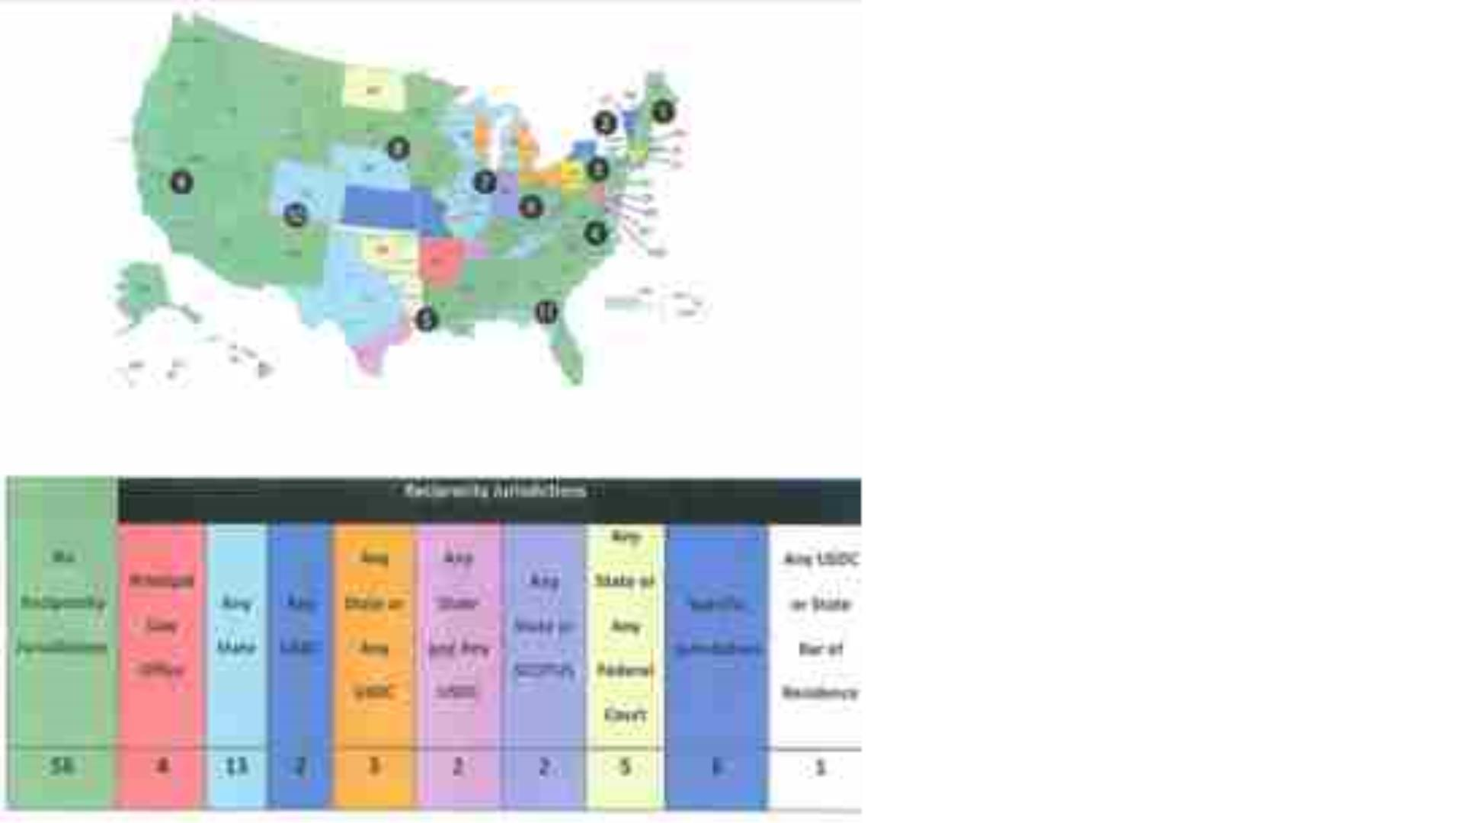
Reciprocal Discipline
In the Matter of
Jason Edward Rheinstein
Revocation After Hearing
(MD)
In the Matter of Rachael
Alexandra Schmid Moshman
Seven-Month Suspension
with 30 Days Stayed, One
Year Probation with Terms
(DC)
68

Slide 69
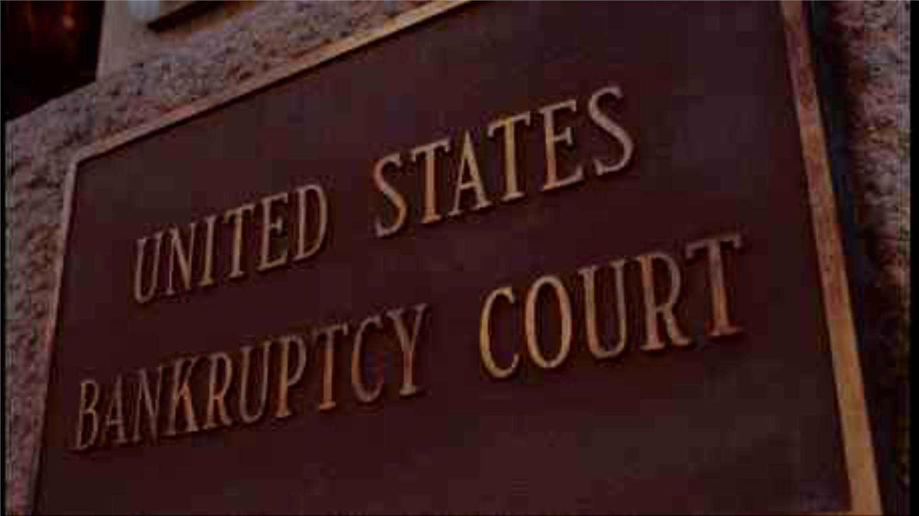
In the Matter of John Carter Morgan, Jr.
One-Year Suspension with Terms
In the Matter of Guillermo Uriarte
90-Day Suspension
69

Slide 70

Criminal
Convictions 13-
22
Consents to Revocation
• In the Matter of Morris Andrew
Bander
• In the Matter of Martin Michael
Brennan, Jr.
• In the Matters of Matthew
James Erausquin.

Slide 71

In the Matter of
Aimee Sangster
Clanton
30-Day Suspension
With Terms
71

Slide 72

For more details, Memorandum Orders
can be accessed on the VSB website:
https://www.vsb.org/attorney/attSearch.asp?S=D
72

Slide 73

The Disciplinary System
Protection of the Public
“Compliance with the Rules, as with all law in
an open society, depends primarily upon
understanding and voluntary compliance,
secondarily upon reinforcement by peer and
public opinion and finally, when necessary,
upon enforcement through disciplinary
proceedings.”
Preamble, Rules of Professional Conduct.
This Photo by Unknown Author is licensed under CC BY-ND

Slide 74

Self-Regulation
• The Preamble to the Rules of Professional Conduct (Rules)
reminds us of our duties to the profession and to the public.
http://www.vsb.org/pro-guidelines/index.php/rules/preamble/.
• The privilege of being a self-governing, relatively autonomous,
profession carries with it the responsibility of assuring that our
behavior conforms to the Rules and serves the public interest.
• “Compliance with the Rules, as with all law in an open society,
depends primarily upon understanding and voluntary compliance,
secondarily upon reinforcement by peer and public opinion and
finally, when necessary, upon enforcement through disciplinary
proceedings.” Preamble, Rules of Professional Conduct.
• Additionally lawyers should assist each other in upholding the
Rules. The Preamble instructs, “Neglect of these responsibilities
compromises the independence of the profession and the public
interest it serves.”
74

Slide 75

Self-Regulation
“Many of a lawyer's professional
responsibilities are prescribed in the Rules
of Professional Conduct, as well as
substantive and procedural law. However,
a lawyer is also guided by personal
conscience and the approbation of
professional peers. A lawyer should strive
to attain the highest level of skill, to
improve the law and the legal profession,
and to exemplify the legal profession's
ideals of public service.”
Rules are a baseline, not a ceiling.
75

Slide 76

VSB Disciplinary System
The Disciplinary System exists to protect
the public.
See Rules of the Supreme Court of Virginia,
Part Six, Section IV, Paragraph 13,
http://www.vsb.org/pro-guidelines/index.php
76

Slide 77

Call the Ethics Hotline: Any Virginia
lawyer may seek informal ethics or
unauthorized practice of law advice
by calling the Ethics Hotline at (804)
775-0564. You will be prompted to
leave a voice mail message, and
your call will be returned in the order
of receipt.
VSB ETHICS
HOTLINE
Email the Ethics Hotline: Any Virginia
lawyer may submit a legal ethics
question online. Depending on the
complexity of your question, you will
receive either an email response or a
return phone call. The ethics staff
strives to respond to your questions
within the same day.
77
This Photo by Unknown Author is licensed under CC BY-NC-ND

Slide 78
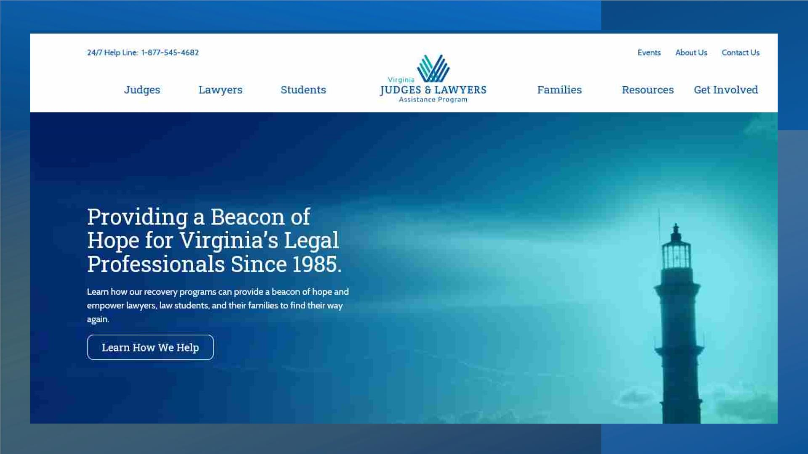

Slide 79

What is the
Virginia State Bar
Clients’ Protection
Fund?

Slide 80
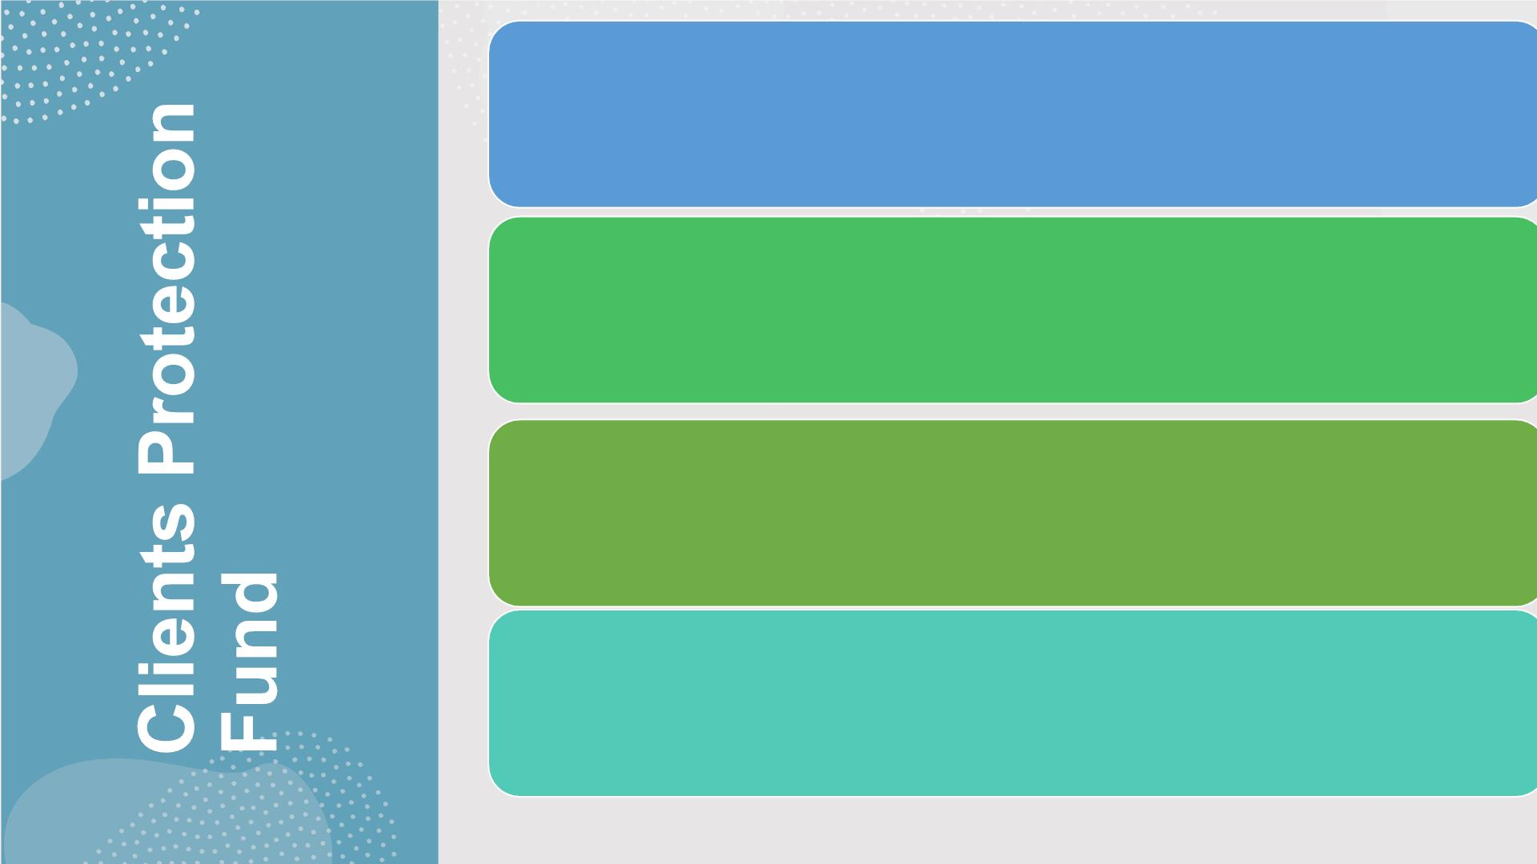
Monetary awards to persons who suffer financial
losses due to dishonest conduct of Virginia
lawyers
Covers lawyers who are suspended or revoked
for disciplinary reasons OR deceased without
sufficient resources to make petitioners whole.
Maximum payment: $75,000 per petitioner
Managed by 14-member board of volunteers that
investigates and decides all claims.

Slide 81

Funded entirely by Virginia lawyers with an
annual fee of $5, set by Supreme Court
of Virginia.

Slide 82

Staff can answer questions and
help people file claims!
Click, email or call:
www.vsb.org/site/public/clients-protection-fund.
cpf@vsb.org
Vivian R. Byrd, Fund Administrator
Jane A. Fletcher, Counsel
804-775-9426
804-775-0567

Slide 83

Thank you!
Your interest in these cases and
collective, meaningful participation is
critical to effective self-regulation.
83

