Slide 1
MEDIATING LEGAL DISPUTES
VIRGINIA BEACH BAR ASSOCIATION
…
JUDGE H. THOMAS PADRICK, JR (RET)

Slide 2
The Basics of Mediation
Preserves relationships
Provides durable resolution of disputes
Preserves confidentiality
Avoids establishing legal precedents
Interested parties have more control over the process
Parties
Attorneys
Management

Slide 3
Mediation Vs. Litigation
Confrontational
Takes time
Rights-determining
Expensive
No guarantee of confidentiality
Co-operative
Quick
Problem-solving
Inexpensive
Private

Slide 4
Value/Benefits of Mediation
No perfect contracts
Defines and facilitates mutual agreement for dispute resolution process
Saves time and anguish
Enables parties to maintain control of outcomes
Maintains/Improves relationships
Results are in writing and requires agreement by parties involved
Reduces court cases and related costs

Slide 5
The Basics in Mediating Legal Disputes
Premeditation Contacts
Discovery Complete?
Status of Pending Trials
Trial Venues – Demographics

Slide 6
Essential Players with Decisional Authority?
Insurance adjusters with appropriate settlement authority
The trustee and all beneficiaries of a trust
Will and estate beneficiaries

Slide 7
Common Problems with Decisional Authority:
Inadequate authority and missing players
Confidentiality issues

Slide 8
Mediating Legal Disputes
Finding common ground
Different methods for different category of cases
Torts
Estate disputes
Employment conflicts
Divorce
Business dissolution
Zoom or Live?
Opening session or direct private caucusing
Eminent Domain

Slide 9
Confirming Settlements at a Mediation
Essential typed agreement at the mediation
Agreed terms of the settlement finalized and executed at the conclusion of the mediation.
Prevents Buyers' remorse

Slide 10
Client Unrealistic Expectations
Client’s Education
What to expect in reality

Slide 11
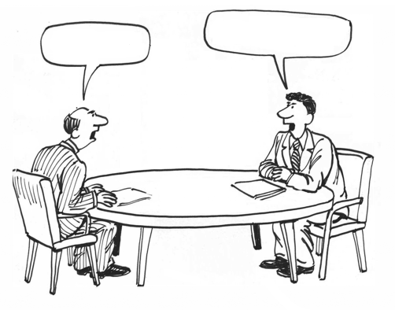
Barriers to Settlement
$ 1,000,000
$ 1,500
Copyright 2022 Michael G. Balmages

Slide 12
Some reasons why defendants and/or their counsel do not want to settle
We can win this.
I don’t want to discount my claim.
We can’t let that jerk get away with this.
I want to make sure he/she never does this to anyone else ever again.
We’re in no hurry, we can wait it out.
We have too much invested in this case to settle.
We must go to trial to maintain our credibility.
It’s a matter of principle!
Copyright 2022 Michael G. Balmages

Slide 13
Some reasons why defendants and/or their counsel do not want to settle
The time value of money.
The plaintiff does not have the staying power.
We can defend this.
We should set an example, otherwise everyone will sue us.
I’d rather pay my lawyer than pay that jerk anything.
My associate needs trial experience.
My firm's reputation
It’s a matter of principle!
Copyright 2022 Michael G. Balmages

Slide 14
TROUBLE FROM BOTH SIDES:
The lawyers’ frequent failure to convey to their clients just how expensive and painful litigation really is.
Lawyer bravado, or the lawyer’s inability to admit that the other side might have a good case or a good defense.
Lawyers believing their own B.S.
Not managing expectations

Slide 15
The hardest person to settle with is the person who is not in the room:
Significant other (husband, wife, best friend, lover)
Boss
Adjuster
Partner
Cousin/Friend Who is a Lawyer
The Trial Lawyer
Copyright 2022 Michael G. Balmages

Slide 16
To counter or not to counter – I’m not gonna bid at all until …
I don’t want to signal …
We’re moving up too fast
Last, best, and final
I don’t want you to tell them … because …
I don’t want them to think we’d go there
I don’t want to bid against myself
Brackets
Over-Thinking
Copyright 2022 Michael G. Balmages

Slide 17
They’re not here in good faith
That’s higher than their pre-mediation demand
That’s lower than their pre-mediation offer
We’ve come down $30,000 and they have only gone up $1,500
We’ve doubled our offer (from $2,500 to $5,000), and they’ve only come down 10%
We don’t want to waste your time
"The time spent on any item of the agenda will be in inverse proportion to the sum [of money] involved.” Parkinson’s Law of Triviality
Work towards your target
Over-Thinking
$ 1,000,000
$ 1,500
Copyright 2022 Michael G. Balmages

Slide 18
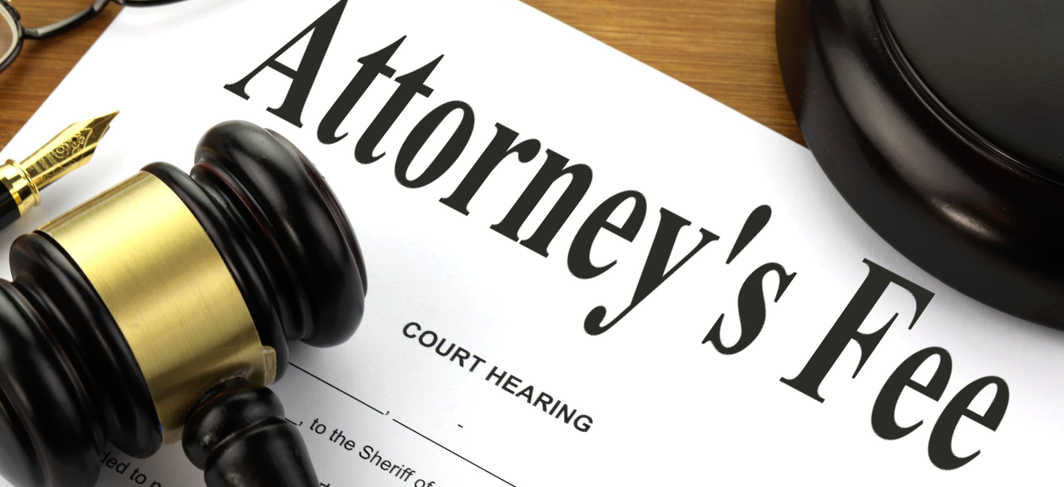
Barriers to Settlement
Copyright 2022 Michael G. Balmages

Slide 19
Constituencies
Plaintiff
Counsel
Costs/Liens
Defendant: If you’re going to settle, you’ve got to pay money to these 3 constituencies
Copyright 2022 Michael G. Balmages

Slide 20
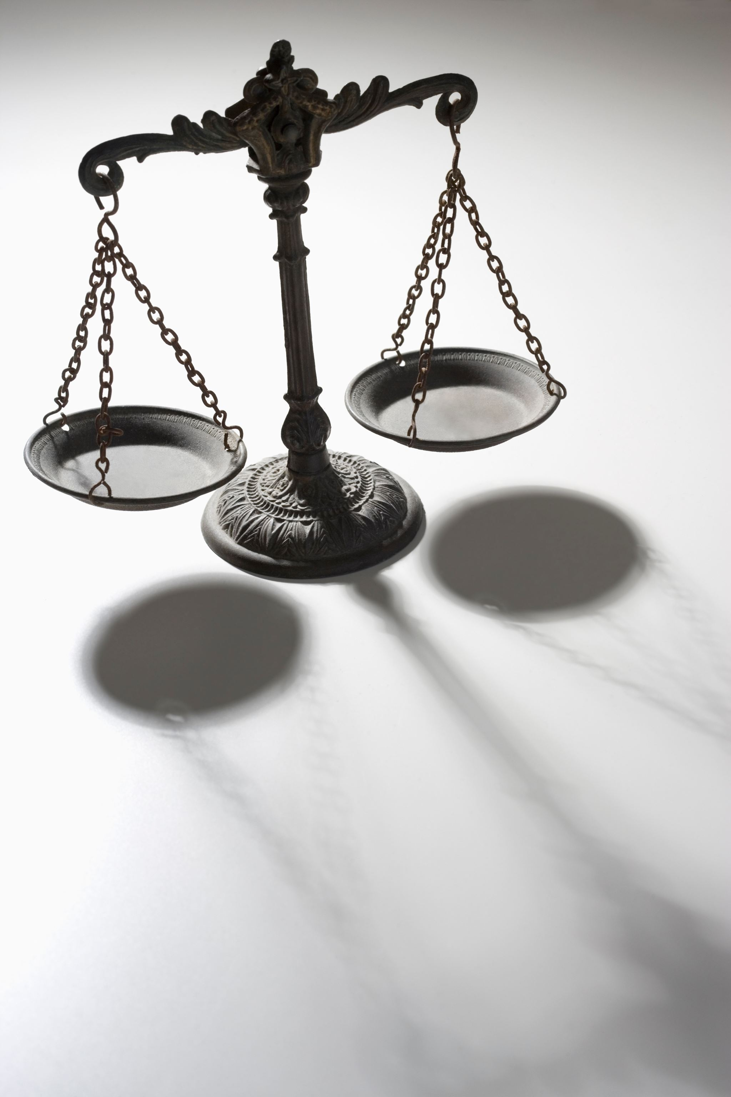
Irrelevancies(?)
Fairness
Justice
Equity
Maybe also the facts and the law.
Copyright 2022 Michael G. Balmages

Slide 21
Bottom Lines & Top Lines
Money (Cash) Talks – Bag of Money
No Good Deed Goes Unpunished
The “dance” –The Process Works
Settlement Agreements
Releases – Mutual?
Confidentiality - Mutual?
Non-Disparagement - Mutual?
Tax Treatment
Parties Bear Own Costs & Fees
Liquidated Damages
Other Relevant Issues
Copyright 2022 Michael G. Balmages

Slide 22
Mediation Briefs
No Plaintiff Demand; No Chance for Defendant/Insurer to Evaluate
"New" Evidence First Presented at Mediation
Lawyer Not Prepared For Mediation - No Strategy/Target
Client Not Prepared For Mediation - Doesn’t Know How It Works
No Skin the game
Liens
Blackmail/Extortionary Threat
Normal restraints missing
Vengeance
More To Talk About
Copyright 2022 Michael G. Balmages

Slide 23
THE MEDIATOR'S PROPOSAL
“I define the mediator's proposal as the exact point in time where the mediator ran out of skills.”
“Some mediators use it as a tool of self- importance in a way that says, ‘Here, I’ll resolve this for you.’”
“Could it be that if more mediators possessed ... a wider variety of skills and techniques, then the mediator’s proposal might quietly slip away?”
“Unfortunately, I think many counsel looking for a mediator’s proposal are more lazy than savvy.”

Slide 24
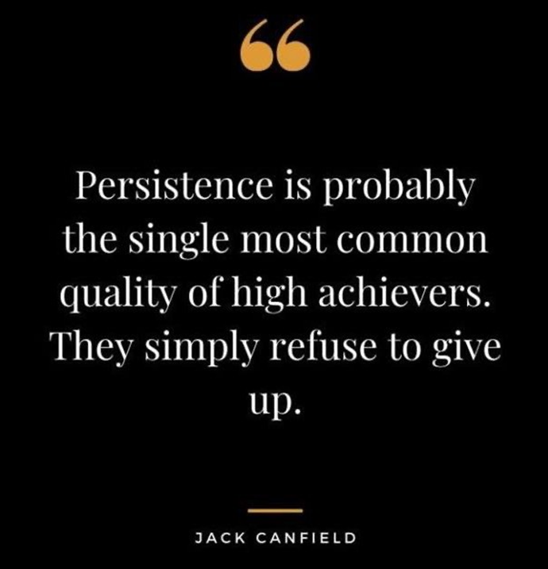
Mediator’s Keys to Success
Rapport
Persistence
Copyright 2022 Michael G. Balmages

Slide 25
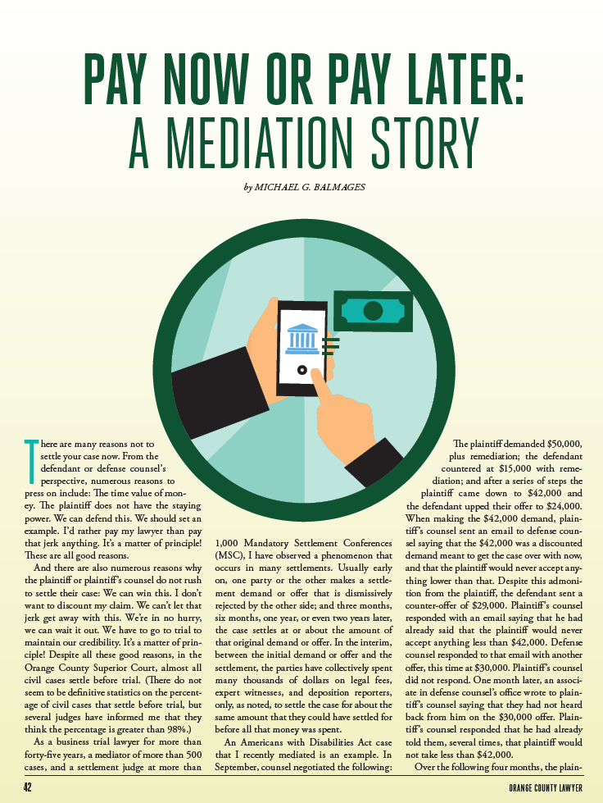
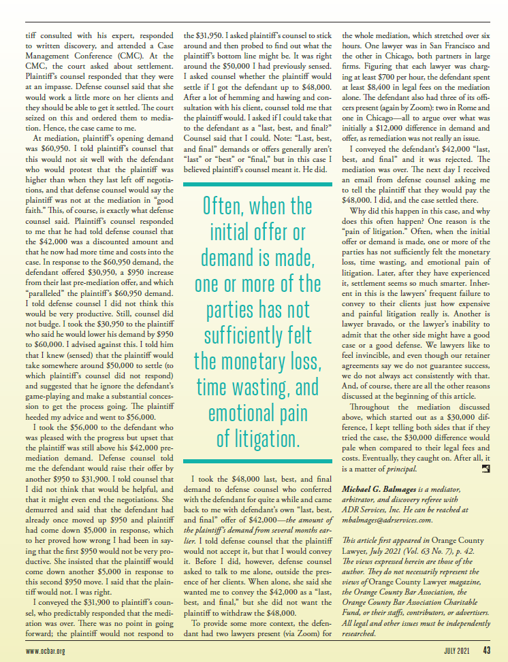

Slide 26
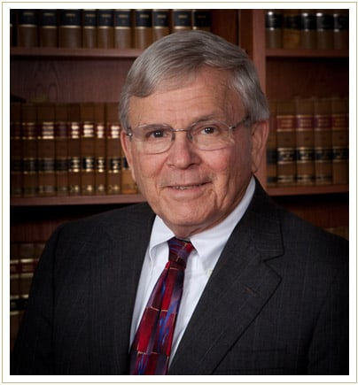
Thanks!
RETIRED JUDGE
DISPUTE RESOLUTION
SERVICES LLC
P.O. BOX 9816,
VIRGINIA BEACH,
VA 23450
www.jpadrick.com
judgepadrick@theretiredjudge.com
(757) 403-8150

Slide 27
Special thanks to Michael C. Balmages, Esq., mediator & Arbitrator with ADR Services, Inc. of Orange County California for the use of some of his slides and the attached article.

