Slide 1
Department of Juvenile Justice
AMY FLORIANO
DIRECTOR

Slide 2
Overview

Slide 3
Roles & Responsibilities
The Virginia Department of Juvenile Justice (DJJ) operates:
30 court service units (CSUs)
1 juvenile correctional center (JCC) – Bon Air
DJJ audits/certifies or approves:
32 CSUs, including 2 locally operated CSUs
24 juvenile detention centers
Bon Air JCC
9 community placement programs (CPPs) and 9 detention reentry programs
15 group homes, shelters, and living programs
76 Virginia Community Crime Control (VJCCCA) plans across 133 localities

Slide 4
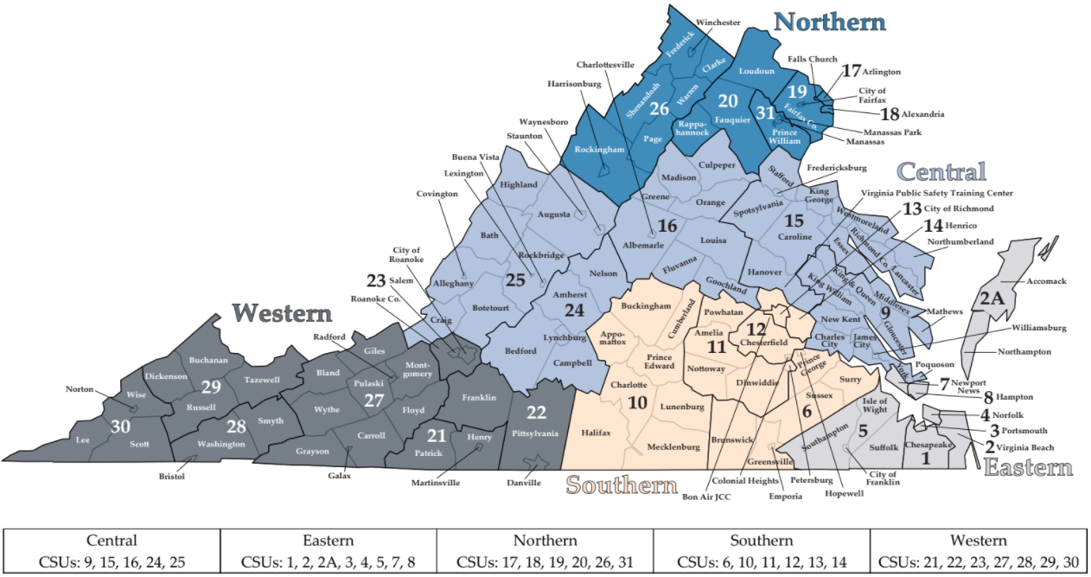
Administrative Regions
Effective in FY 2022, CSUs 23 and 23A are combined (CSU 23), and CSUs 20L and 20W are combined (CSU 20).
Notes:
The 32 CSUs across the state are grouped into five administrative regions.
30 CSUs are state-operated. Two are locally operated (Falls Church and Fairfax).
Regional program managers (RPMs) are each assigned a region.
Regions are not consistent with nearly any other artificial catchment or jurisdictional boundaries, except no counties or cities are split.

Slide 5
CSUs

Slide 6
CSU Duties/Responsibilities
Required per 16.1-234
Intakes
  Domestic Relations and Child Welfare (DR/CW)
  Juvenile (e.g., Delinquency and Status Offenses)
Social History and Other Reports
  e.g., Youth Assessment Screening Instrument (YASI)
Probation Supervision
Parole Supervision
Notes:
Required by the COV
Intakes
DR/CW complaints include issues, such as:
Custody (temporary and permanent)
Child support
Child visitation
Protective orders, foster care prevention, abuse and neglect (removal orders, etc.) – less often if at all
Juvenile complaints include delinquent, technical, traffic, status, and other offenses.
Status offenses include those acts that are punishable by law for a minor, but not for an adult. For example, truancy, running away, and curfew violations are status offenses. CHINS/CHINSup are considered status offenses.
CHINS can be established when a child’s behavior poses clear and substantial danger to himself/herself or others. The intervention of the court must be essential to provide treatment, rehabilitation, or services needed by the child and/or the child’s family.
CHINSup can be established when a child is chronically truant from school, runs away from home on multiple occasions, or escapes from a court-ordered residential placement.
CSUs are responsible for receiving, reviewing, and processing intake complaints for domestic relations/child welfare and juvenile cases.
Juveniles intake cases can be petitioned, ordered to detention, diverted, or resolved.
CSU staff complete social histories and other reports, including the YASI, to make a recommendation to the court regarding the disposition of the case.
YASI
A validated tool which provides an objective classification of a youth’s risk of reoffending by assessing static and dynamic risk and protective factors
Guides and informs the youth’s areas of need, case planning, and the most appropriate disposition for recommendation to the court
Readministered every 180 days
As of October 15, 2015, the YASI has become an integral part in determining a youth’s LOS based upon their risk of reoffending on their most recently administered assessment
CSUs oversee probation, parole, and re-entry services.

Slide 7
Juvenile Supervision and Intakes, FY 2022
Average of 1,725 youth per day under DJJ supervision*
  1,368 on probation supervision
  195 in direct care
  161 on parole supervision
Average of 349 youth per day in detention
Of 32,803 juvenile intake complaints:
  62% were petitioned
  18% were diverted
    79% had successful outcomes
  9% were resolved
The number of youth under supervision does not include the number of youth in diversion programs.
Notes:
Data Source: DRG

Slide 8
Intake Cases by Demographics, FY 2021 vs 2022
2021 2022
Age
  16 years or older: 55%
Sex
  Males: 67%
  Females: 33%
Race
  White: 49%
  Black: 41%
Age
  16 years or older: 47%
Sex
  Males: 65%
  Females: 35%
Race
  White: 49%
  Black: 41%
Notes:
Data Source: DRG

Slide 9
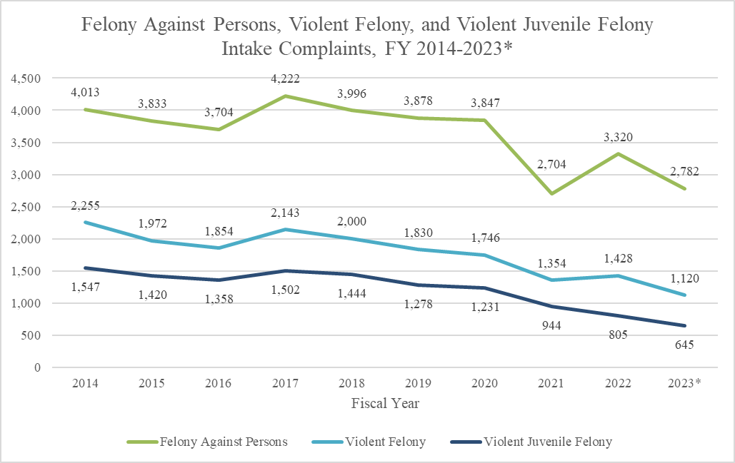
Violent Crime Trends
FY 2023 is partial year of data as of 3/30/2023.
Felony against persons complaints are categorized based on the DAI ranking. Violent felony complaints include offenses enumerated in § 19.2-297.1 in addition to aggravated murder in § 18.2-31 of the Code of Virginia. Violent juvenile felony include offenses enumerated in §§ 16.1-269.1(B) and 16.1-269.1(C) of the Code of Virginia when committed by a youth 14 years of age or older; however, only offenses considered violent juvenile felonies without being contingent on a youth's other offenses are included. The three groups are not mutually exclusive.

Slide 10
Juvenile Intake Cases,
FY 2013 – 2022
Intake cases decreased 49% (22,743 cases) since FY 2013.
Following a substantial decrease in FY 2021, there was an increase of 32% in juvenile intake cases from FY 2021 to FY 2022.
Notes:
Data Source: DRG

Slide 11
Juvenile Intake Cases by Most Serious Offense, FY 2013 – 2022
 | 2013 | 2017 | 2022
Felonies – Against Persons | 5% | 7% | 9%
Felonies – Weapons/Narcotics Distribution | 1% | 1% | 1%
Felonies – Other | 9% | 10% | 6%
Class 1 Misdemeanors – Against Persons | 15% | 14% | 22%
Class 1 Misdemeanors – Other | 24% | 20% | 15%
Probation/Parole Violations | 9% | 7% | 4%
Contempt of Court/Failure to Appear | 8% | 8% | 8%
Status Offenses | 18% | 21% | 25%
Other | 12% | 13% | 10%
Total Intake Cases | 46,305 | 39,137 | 23,557
Felony against persons offenses increased from 5% of all intake cases in FY 2013 to 9% in FY 2022.
Status offenses increased from 18% to 25% of intake cases.
Offense severity was determined by the Detention Assessment Instrument (DAI) ranking.
Notes:
The Detention Assessment Instrument (DAI) Offense Severity is one way of measuring the severity level of juvenile offenses.
“Other” Felonies include arson, burglary, escapes, grand larceny, and vandalism.
Data Source: Query on 1/11/23

Slide 12
JUVENILE FIREARM/WEAPON INTAKE COMPLAINTS
FY 2018-2022

Slide 14
Juvenile Homicide Victims by Homicide Type
CY 2013-2022*

Slide 15
Regional Investigative Specialists
Regional Gang Intervention Program
Regional Task forces involving LEOs, CSUs, Probation, CWAs, etc to identify and intervene on gang trends and activity within your regions.
Implementing the G.R.E.A.T. Program, and gun violence intervention programming. 12 cities given priority, will be open to all jurisdictions.

Slide 16
Firearm Updates
Diversion prohibited for firearm offenses, and firearms and imitation firearms on school grounds
Mandatory DAI override for all firearm offenses
Diversion and Mandatory DAI override for all violent offenses under 19.2-297.1 ( not just “violent juvenile felonies”)

Slide 17
System overview
INTAKE (DJJ DECIDES TO ISSUE PETITION OR DIVERT)
PETITION (COMMONWEALTH DECIDES- TO TRY AS AN ADULT OR LEAVE IN JDR)
JDR (JUVENILE CONVICTION)
CIRCUIT (ADULT CONVICTION)
DIVERSION
SUCCESSFUL: NO CHARGES
ADULT (DOC ONLY)
BLENDED SENTENCE (DJJ THEN DOC)
SERIOUS OFFENDER (DJJ ONLY)
SERIOUS OFFENDER COMMITMENT
INDETERMINATE COMMITMENT
PROBATION
JUVENILE COMMITS OFFENSE- OFFICER DEVELOPS PROBABLE CAUSE

Slide 18
Diversion Plans, FY 2022
Of 32,803 juvenile intake complaints:
  18% were diverted
    79% had successful outcomes
  9% were resolved
Examples of diversion programs:
Individual/family counseling
Anger management
Restorative justice
Law-related education
Shoplifter’s alternative
Notes:
Diversions are the handling of a juvenile intake complaint in an informal manner rather than through the official court process, as described in the Code of Virginia. (Complaints may also be resolved without a diversion plan.)
In order for an intake complaint to be diversion eligible, it must be the youth’s first felony, a misdemeanor with no prior felonies, or a truancy that fits the criteria in the Code.
Intake officers must develop a plan for the youth, to which the youth and family must agree.
Informal supervision is limited to 120 days
Intake officers have some discretion to choose which types of diversion programs youth can participate in based upon the youth’s individualized needs and available options.
The percentage of juvenile intake complaints diverted could potentially be attributed to a variety of reasons, including local decision-making practices, availability of local resources, Commonwealth’s Attorney practices, and judicial guidance.
Diversion cases are considered successful if the youth is able to satisfactorily complete the diversion plan as set forth by the intake officer within the timeframe.
Diversion cases may not yield successful outcomes due to a variety of reasons, such as the youth’s failure to attend programmatic activities.
Data Source: DRG

Slide 19
DIVERSION UPDATES
December 13, 2021: JLARC issued several recommendations, one specifically regarding Diversion.
Starting February 1:
Affirmative consent for all offenses under the Victims rights statute prior to diversion.
No diversion if the victim is a law enforcement officer, or a teacher or school employee, engaged in the course of their employment.
Intake workers will need to have a conversation with law enforcement prior to diverting, to seek history and input.
Limit on number of times a youth can be diverted: once on a felony, no more than two misdemeanor offenses.

Slide 20
PRE-COURT SERVICES
ALL CSUs STARTING JUNE 1, 2022
5 business days or arraignment
Voluntary participation, unless court ordered
Option in lieu of detention
Funded by VJCCA services includes electronic monitoring, and all available services under your VJCCA Plan.

Slide 21
VJCCCA, FY 2022
4,401 youth placed
Service examples:
  Intensive supervision
  Electronic monitoring
  Case management
  Parenting skills
  Mentoring
Expenditures
  Localities: 56%
  State: 44%
MOE = maintenance of effort (paid by localities)
VJCCCA data do not include prevention services.
Notes:
Background
The General Assembly enacted VJCCCA in 1995 “to establish a community-based system of progressive intensive sanctions and services that correspond to the severity of offense and treatment needs” so that all localities could implement programs and services to meet the needs of youth involved in juvenile justice system.
Effective in FY 2020, VJCCCA’s purpose in § 16.1-309.2 of the Code of Virginia was amended to “deter crime by providing community diversion or community-based services to juveniles who are in need of such services and by providing an immediate, effective punishment that emphasizes accountability of the juvenile offender for his actions as well as reduces the pattern of repeat offending.”
As part of VJCCCA legislation a maintenance of effort (MOE) was established requiring all localities to expend an amount equal to the sum of their FY 1995 expenditures for pre-dispositional and post-dispositional block grant alternatives to secure detention.
Each biennium, localities must develop a plan for the use of their VJCCCA funds and the plan must be approved by the Board of Juvenile Justice.
All programs and services funded through VJCCCA must improve public safety, hold youth accountable for their behavior (sanctions) or improve a youth’s capacity for positive behavior (skills and treatment).
Youth served (pg. 33)
There were 6,662 total program placements in FY 2022.
Completion status (pg. 34)
Of the 7,165 programs that were closed in FY 2022, 76.8% had a satisfactory completion status.
Services:
Out of all services, outreach detention/electronic monitoring and community service were the most common service types in FY 2022.
See page 33 for additional information on placements by service category and type.
Rearrest for placements and releases (pg. 83)
Within 12 months, 27.2% of FY 2021 VJCCCA placements were rearrested and 24.8% of VJCCCA releases were rearrested.
Expenditures (pg. 34)
Localities paid 56.1% of the total expenditures for VJCCCA programs. $5,787,513 came from Maintenance of Efforts and $3,947,947 came from additional local funding. The state paid 43.9%, equating to $7,632,872.
Data Source: DRG

Slide 22
Probation, FY 2022
1,543 probation placements
Average age at placement was 16.1 years
32% of placements were high-risk
Average length of stay (LOS) for releases was 12.4 months
Risk levels were determined by the Youth Assessment Screening Instrument (YASI).
Notes:
Data Source: DRG

Slide 23
Parole, FY 2022
131 parole placements
Average age at placement was 18.3 years
86% of placements were high-risk
Average LOS for releases was 13.4 months
Risk levels were determined by the Youth Assessment Screening Instrument (YASI)
Notes:
Data Source: DRG

Slide 24
COMMITMENT TYPES

Slide 25
Direct Care Admissions Average Ages, FY 2022
First Behavior Problems: 11.4
First Community Intervention: 12.5
First Adjudication: 14.0
Direct Care Admission: 17.1
Notes:
Data Source: DRG and Query on 1/11/23

Slide 26
Direct Care Admissions Most Serious Committing Offenses, FY 2013 – 2022
 | 2013 | 2017 | 2022
Felonies – Against Persons | 46% | 53% | 70%
Felonies – Weapons/Narcotics Distribution | 3% | 4% | 5%
Felonies – Other | 33% | 31% | 18%
Class 1 Misdemeanors – Against Persons | 6% | 4% | 4%
Class 1 Misdemeanors – Other | 7% | 4% | 1%
Parole Violations | 6% | 4% | 1%
Total Admissions | 439 | 332 | 147
The percentage of felonies against persons and felonies for weapons and narcotics distribution increased among admissions since FY 2013 while other offense severities decreased in proportion.
Notes:
Data Source: Query on 1/11/23

Slide 27
Direct Care Admissions Family Experiences, FY 2022
57% - parent incarceration
61% - parent criminal violence
44% - parent substance abuse
6% - parent abandonment
16% - parent death
25% - family domestic violence
  74% reported at least one of the above
  40% reported three or more of the above
Notes:
Data Source: Query on 1/11/23

Slide 28
Direct Care Admissions
Mental Health Disorders, FY 2022
The majority (93%) of youth appeared to have at least one symptom of attention deficit hyperactivity disorder (ADHD), conduct disorder, oppositional defiance disorder, or substance use disorder.
One youth may be included in multiple categories.
Notes:
Data Source: DRG

Slide 29
COMMITMENTS
Post-Dispositional transfer of custody to DJJ
INDETERMINATE VS. DETERMINATE
16.1-285: INDETERMINATE, 36 MONTH OR 21
LOS V. COURT REVIEWS

Slide 30
Outcomes of 2015 LOS Changes
Treatment completion declined.
No overall reduction in recidivism, but a proportional increase in violent offenses.
Negative Judicial System response.
JLARC: "DJJs current approach to determining length of stay for indeterminately committed youth may be undermining its rehabilitative goals." - December 13, 2021

Slide 31
Treatment Completion Rates for
Aggression Management Treatment Needs
Data includes indeterminate direct care releases only. Youth with mandatory or inpatient sex offender treatment needs are excluded. Canceled, rescinded, and successfully appealed commitments are excluded. In the FYs following the 2015 LOS Guidelines implementation, youth were released under both the 2008 and 2015 LOS Guidelines. Rates for small groups can be strongly influenced by the completion status of only one or two youth.

Slide 32
Treatment Completion Rates for
Substance Abuse Treatment Needs
Data includes indeterminate direct care releases only. Youth with mandatory or inpatient sex offender treatment needs are excluded. Canceled, rescinded, and successfully appealed commitments are excluded. In the FYs following the 2015 LOS Guidelines implementation, youth were released under both the 2008 and 2015 LOS Guidelines. Rates for small groups can be strongly influenced by the completion status of only one or two youth.

Slide 33
2022 GUIDELINES
Four Tiers, Match risk and offense level under tiers that reflect the intent and severity of the offense and associated treatment needs
Clear guidelines for release ( complete mental health treatment, vocational programming, no serious behavioral infractions for a specific period)
Built in option for early release, to incentivize internalization of pro-social behaviors
Stronger re-entry provisions to include step-down, work release, and furloughs to gradually re-entry the community with complete continuity of care.

Slide 34
SERIOUS OFFENDER
COMMITMENT
(i) the juvenile is on parole for an offense which would be a felony if committed by an adult
(ii) the juvenile was committed to the state for an offense which would be a felony if committed by an adult within the immediately preceding twelve months
(iii) the felony offense is punishable by a term of confinement of greater than twenty years if the felony was committed by an adult, or
(iv) the juvenile has been previously adjudicated delinquent for an offense which if committed by an adult would be a felony punishable by a term of confinement of twenty years or more, and the circuit court, or the juvenile or family court, as the case may be, finds that commitment under this section is necessary to meet the rehabilitative needs of the juvenile and would serve the best interests of the community, then the court may order the juvenile committed to the Department of Juvenile Justice for placement in a juvenile correctional center for the period of time prescribed pursuant to this section.

Slide 35
SERIOUS OFFENDER REVIEWS
2 YEARS, EVERY YEAR THERAFTER ( 60 Day review option)
REPORT GENERATED FROM THE DEPARTMENT
SHOULD HAVE BEHAVIORAL REPORTS, RECOMMENDATIONS FOR OPTIONS IF THEY CONTINUE, OR IF THEY ARE RELEASED.
KEEP IN MIND PHASE LEVELS DO NOT GO BACKWARDS
CPP VS BON AIR

Slide 36
Vocational Programs
Prior to FY 2022
Forklift Simulator
Welding Simulator
FY 2022-2023
HVAC
Electrical
Plumbing
C-Tech
(fiber optics, grounding and bonding and copper installation)
Live Welding (CPP)
*Vocational opportunities in all CPPs

Slide 37
Wrap around services in place to support
Workforce development center
Workforce development coordinator
RFP for workforce development community partnerships
Statement of needs and MOA revisions for the CPPS, work release, furloughs
Revision of Education plans to offer vocational as elective
Counseling, mentors and vocational supports for financial needs.

Slide 38
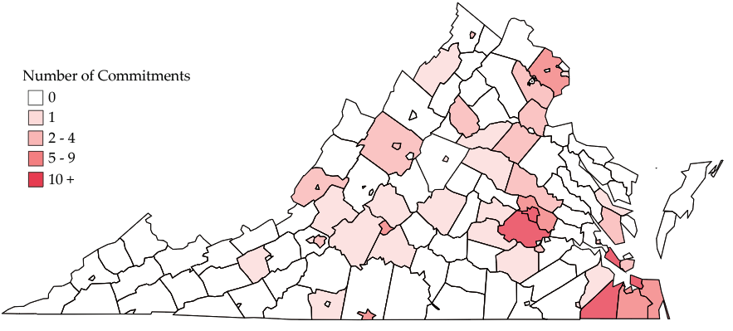
Commitments by Locality,
FY 2022
86 of 133 localities (65%) had no commitments in FY 2022.
Data exclude subsequent commitments.
Notes:
Data Source: DRG

Slide 39
12-Month Rearrest Rate for Indeterminate Commitment Releases, FY 2013-2021
Rearrest rates did not decline after the 2015 LOS Guidelines (until COVID-19 impacts).

Slide 40
Recidivism for Violent Offenses Increased
 | Fiscal Year |  |  |  |  | Total
 | 2016 | 2017 | 2018 | 2019 | 2020
Total Rearrests (Any Offense) | 49.9% | 55.0% | 56.3% | 54.4% | 49.7% | 52.9%
Select Felony Rearrests
Assault | 11.6% | 9.4% | 14.4% | 12.3% | 14.0% | 12.3%
Weapons | 7.8% | 7.9% | 13.1% | 11.0% | 15.3% | 10.8%
Robbery | 7.2% | 5.8% | 8.4% | 7.8% | 7.1% | 7.3%
Murder | 1.3% | 1.2% | 2.5% | 1.9% | 1.9% | 1.8%
Kidnapping | 1.3% | 1.8% | 1.9% | 1.3% | 1.3% | 1.5%
Sexual Abuse | 0.8% | 0.3% | 1.3% | 0.3% | 0.6% | 0.7%
Select Felony Total | 18.9% | 18.8% | 25.6% | 21.4% | 27.3% | 22.2%
Select Misdemeanor Rearrests
Assault | 9.3% | 9.7% | 9.4% | 6.5% | 9.4% | 8.9%
Weapons | 5.4% | 7.6% | 9.4% | 9.1% | 11.4% | 8.4%
Select Misdemeanor Total | 13.7% | 16.4% | 16.9% | 14.6% | 19.8% | 16.2%
Total Select Offense Rearrests | 26.6% | 27.1% | 31.9% | 27.5% | 34.7% | 29.4%

Slide 41
Days to Rearrest, FY 2015-2019, tracked through FY 2020

