Slide 1
Bond Hearings in general district court
Paul D. Merullo, Judge
Virginia Beach Bar Association Bench/Bar Conference
August 15, 2024

Slide 2
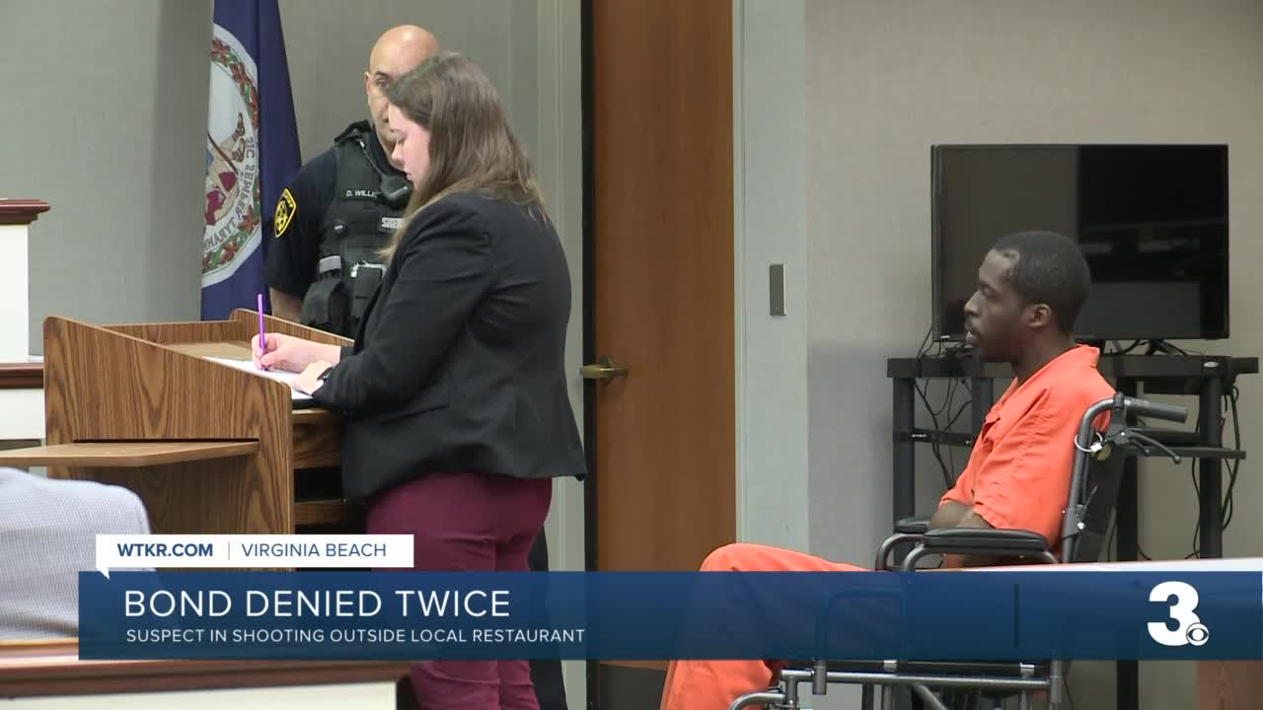
Bond hearings: One of the most consequential proceedings in General District Court, yet a typical bond hearing lasts 5 to 15 minutes.

Slide 3
An illustrative misdemeanor bond hearing court file:

Slide 4
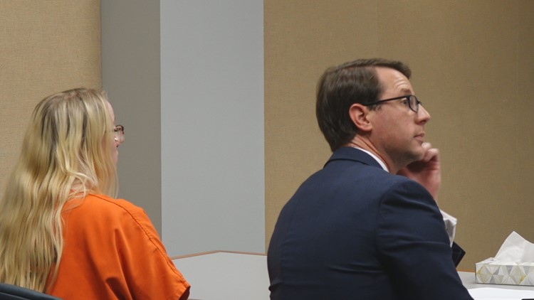
Sample questions defense attorney could ask client if answers are likely to be favorable:
Where will you be living if you are released? Do you own or rent? Is your name on the lease? Who else lives there with you?
Family situation (i.e. married/single, children)
Level of education
Are you employed? Where? What kind of work? Length of employment
Are you currently on probation?
Do you have any other pending charges?
How did you come into contact with police when you were arrested/turned self in?
When did you find out you had an outstanding warrant? (If applicable)
If the court puts you on pretrial supervision can you remain drug/alcohol free and comply with random testing and pretrial appointments?

Slide 5
Sample questions to be posed by prosecutor who is opposed to bond (if answers would be favorable to prosecution):
Do you have other pending charges?
Are you currently on probation?
What was the drug in question in your previous drug conviction (or drug for which you are on probation)?
Have you previously done inpatient substance abuse treatment?
Before you were arrested did you know you had an outstanding warrant?
How did you come into contact with police when you were arrested on this warrant?
Issues that may be adverse to the defendant to be pointed out in CWA proffer:
Weight of the evidence is strong
Prior history of failure to appear/pretrial noncompliance
Pending charges similar to charges before the court
Prior inpatient substance abuse treatment (where new inpatient program is being proposed)
Prior convictions or active probation for conduct similar to charges before the court
Lengthy or bad criminal record generally

Slide 6
Statutory Factors:
Nature and circumstances of offense
Whether a firearm was used
Weight of the evidence
Financial resources of defendant
Character of the accused
Length of time in community
Record of convictions
History of court appearances/FTA
Likelihood to obstruct, intimidate
“any other information available” re: appearance
Va Code 19.2-121

Slide 7
Practice pointer: Defense options if court denies motion for bond:
Appeal to Circuit Court
Ask judge to note “may reconsider if inpatient program is proposed”
Move to reconsider based on proposed inpatient substance abuse program
If possible to enter a plea (for example on a charge of FTA), ask judge if okay to just take a plea (defendant might be held w/o bond only on FTA
Advance defendant’s case to officer’s earlier court date, if any. Check officer traffic AND criminal availability

Slide 8
Commonwealth Attorney May Appeal order granting bond:
“Any bail decision made by a judge of a court may be appealed successively by the person to the next higher court, up to and including the Supreme Court of Virginia, where permitted by law.”
“The court granting or denying such bail may, upon appeal thereof, and for good cause shown, stay execution of such order for so long as reasonably practicable for the party to obtain an expedited hearing before the next higher court.”
Va. Code Ann. § 19.2-124
Question: How often does CWA appeal GDC bond decision to Circuit Court?

Slide 9
Defense motion to reconsider bond Va. Code 19.2-130
Some illustrative examples of reasons:
Defendant suffers a continuance (i.e. Commonwealth’s witness unavailable/did not appear, awaiting lab analysis, CWA stuck in a jury trial)
Weight of the evidence is not as strong as was thought at earlier bond hearing (i.e. defense attorney obtained exculpatory video of incident)
Defense attorney proposes inpatient substance abuse program
Defense attorney proposes a vendor who can provide GPS location tracking or alcohol monitoring
**There is no explicit limit to the number of times a defendant held in custody can move for reconsideration of bond status.

Slide 10
An illustrative case in which defendant is held without bond for FTA but not in custody for the underlying charge:

Slide 11
Being a lawyer is an art and not a science.
How to proceed with a motion for bond will vary, depending on each particular defendant, facts of case, and charges before the court.
Question: Is it better for the defense attorney to proffer for the defendant or to have the defendant testify? Proffers and evidence that would not be admissible at trial can be admitted in a bond hearing. Va. Sup Ct. Rule 2:1101(c)
Question: Are there certain situations where defense attorney will have defendant testify about facts of the case?
Question: If you believe your defendant has zero chance of getting released, do you proceed with a bond hearing as a way to obtain extra early discovery, such as CWA proffer of facts?
Question: Is it effective for prosecutor to question the defendant about his criminal history or best to just proffer that information to the court?
Question: Is it effective for defense attorney to call family members, employer, character witnesses or preferrable that defense attorney proffer?

